Slide 1
SDMX in AFRICA
SDMX Roadmap 2019-2022
7th SDMX Global Conference
Budapest, Hungary from 16-19 September 2019

Slide 2
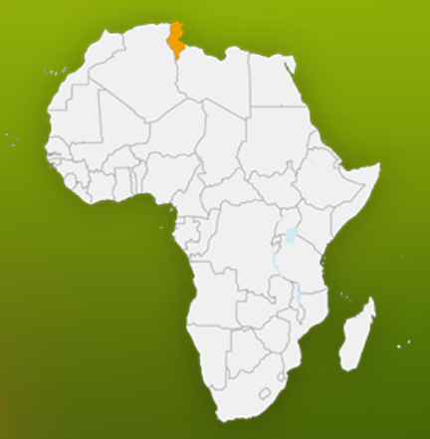
Context
Africa Information Highway(AIH):
Transparency, through a one stop shop for an effortless access to official statistics
Comparable data, through improved harmonization and integration
Seamless data exchange among organizations and countries, using international standards such as SDMX
Reduced countries’ reporting burden, using an SDMX compliant data submission tool to replace manual filling of questionnaires

Slide 3
SDMX roadmap 2019-2022
1
Advocate for the use of SDMX
2
Enhance SDMX skills in Africa
Promote the use and
re-use of high-quality data and metadata powered by SDMX
3
Support SDMX implementation
4
Improve data exchange while reducing reporting burden
5
Better coordinate SDMX work in Africa through regional and international strategic partnerships

Slide 4
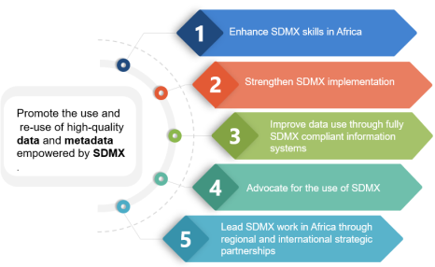
1
Advocate for the use of SDMX
Advocate for the use of SDMX
Done
Communicate about SDMX with senior managers in NSSs
SDMX has become a central component of the AIH
Pending
Explore new avenues at regional and global stages to communicate about the benefits of using SDMX
Document successful African experiences to build strong business cases to better convince high-level management to invest in SDMX

Slide 5
2
Enhance SDMX skills in Africa
60
15
03
Participants
trained
countries
Regional workshops

Slide 6
2
Enhance SDMX skills in Africa
Done
Sponsored African countries’ participation in the last SDMX Global Conference. All countries attended the two days capacity building pre-conference event (2017)
Trainings on the use of SDMX to report SDGs data
Pending
Continue trainings to cover all African countries
Create SDMX pools of experts in countries (training of trainers)
Establish an SDMX Steering committee in partnership with other regional organizations in order to harmonize SDMX activities in Africa
Capacity building and technical assistance at country level for SDG SDMX data exchange

Slide 7
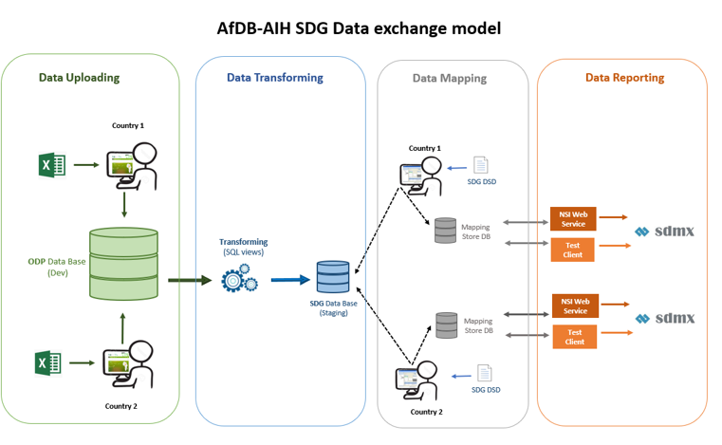
3
Support SDMX implementation
Done
Assist countries in adopting the SDG DSD using ODP (Open Data portal)
Pending
Extend the implementation to other global DSDs
Assist countries willing to create their own SDMX structures

Slide 8
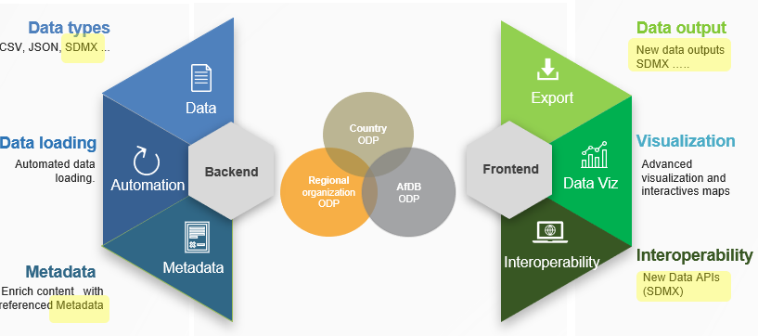
4
Improve data exchange while reducing reporting burden
Done
Export data from ODP in SDMX format
Pending
Upgrade ODP to be fully SDMX compliant
Integrate SDMX RI with ODP

Slide 9
5
Better coordinate SDMX work in Africa through regional and international strategic partnerships
Done
Partnership with IMF to report eGDDS data in SDMX format
Collaboration with UNSD, Eurostat and soon UNICEF
Integrated the “Shared tools Expert Group”
Pending
Expand partnerships
Partnership with Arab Institute for Training and Research in Statistics (AITRS) upcoming
A Steering committee on SDMX implementation in Africa will meet for the first time on the margins of CoDG (November 2019)

Slide 10
SDMX case studies
Senegal
Cote d’Ivoire

Slide 11
Why SDMX ?
Reduce Reporting burden for the Cote D’Ivoire National statistics system
Better report on all International and regional Agendas Cote D’Ivoire has committed to (including SDGs, AU Agenda 2063, etc.)
Standardize our statistical data management lifecycle from collection to dissemination
SDMX as an important component to modernize the National Statistical System

Slide 12
Progress made on SDMX
Trainings on SDMX basics notions, data modelling and data mapping
Testing SDMX tools: SDMX converter, Mapping assistant
Testing the Mapping of SDG data from ODP data base with SDG DSD
Reporting to IMF for the eGDDS implementation
A National Summary Data Page is available to allow partners to retrieve main macro economic data from Cote D’Ivoire’s Open Data Platform

Slide 13
Next steps with SDMX ?
Upgrade our IT infrastructure to better benefit from SDMX project implementation
Finalize the mapping exercise with the official SDG DSD and publish our NSI Web service for SDG
Continue SDMX capacity building
Extend the implementation to other statistical domains
Notes:
Ensure the replication of the data present on the infrastructures of Côte d'Ivoire with that of the infrastructures of the African Development Bank (A.D.B).

Slide 14
Challenges ?
The transition from the Enhanced Data Management System of IMF to the IMF Special Data Dissemination Standard at the end of this year
The dissemination from 2021 of all the indicators and survey results produced by the National Statistics Office of Côte d'Ivoire in SDMX format
The establishment of an SDMX infrastructure specific to Côte d'Ivoire beginning in 2021
Ensure the replication of the data present on the infrastructures of Côte d'Ivoire with those of the infrastructures of the African Development Bank (AfDB) by 2021
Training of all actors of the National Statistical System (SSN) with the support of the African Development Bank ‘(AfDB) in 2020
Integrate the expert groups working on the implementation of SDMX standards

Slide 15
Why SDMX ?
Standardize data exchanges, data with harmonized structure
Improve the quality of exchanges through standardization, automation, validation and data sharing
Improve reading and correct exploitation of data
Reduce data reporting burden with “One report for many organizations”
To correspond with best practices

Slide 16
Progress made on SDMX
Data submission with IMF: SDMX determined for Senegal’s accession to the IMF’s SDDS in 2017
In 2018, Participation in 3 trainings sessions on SDMX (focus on external trade and SDG)
Practices based on SDMX tools (SDMX converter, Mapping assistant)
SDG mapping with SDG-DSD

Slide 17
Next steps with SDMX ?
Continue promoting SDMX at ANSD level: increased awareness of internal producers
Take into account SDMX in updating ANSD’s dissemination policy
Disseminate in Open data the SDG indicators in SDMX format for better use and comparability
Extend the SDMX implementation to other statistical domains (external trade, national accounts and prices)

Slide 18
Challenges ?
Lack of resources (skills, French documentation, budget, etc.) to organize training sessions on SDMX with the participation of representatives of the internal producer services
Review and describe indicators and metadata to ensure comparability at the regional level
Integrate an introduction to SDMX in the training of ENSAE students
Use SDMX format in data dissemination of census 2023

Slide 19
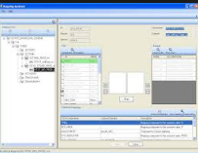
AfDB-AIH SDG Data exchange model (short term)
Data Uploading
Data Transforming
Data Mapping
Data Reporting
Country 1
AfDB
SDG DSD 1.0
Transforming
(SQL views)
ODP Data Base
(Dev)
NSI Web Service for all countries
Mapping
Store DB
SDG Data Base
(Staging)
SDMX_SDG
For all countries
Country 2
Notes:
Short term vision (July – September)
Countries managed the SDG data loading using ODP template
AfDB experts (ECST1 in collaboration with CHIS) create necessary SQL views to get a staging SDG data base. This data base is automatically updated when ODP data base is updated
AfDB experts (ECST1) make Data mapping between the SDG DSD v1.0 and SDG countries data existed in staging data base . This mapping will be made in collaboration with countries
AfDB experts (ECST1 in collaboration with CHIS) will set up a common NSI Webservice to expose SDG mapped data of all countries. The SDGs data will be categorized in separate dataflow by country.

Slide 20
AfDB-AIH SDG Data exchange model (middle term)
Data Uploading
Data Transforming
Data Mapping
Data Reporting
Country 1
AfDB/Country 1
SDG DSD
Mapping
Store DB
NSI Web Service for Country 1
Transforming
(SQL views)
ODP Data Base
(Dev)
SDMX_Country 1
SDG Data Base
(Staging)
SDMX_Country 2
Mapping
Store DB
NSI Web Service for Country 2
SDG DSD
Country 2
AfDB/Country 2
Notes:
Middle term vision (September- December )
Countries managed the SDG data loading using ODP template
AfDB experts (ECST1 in collaboration with CHIS) create necessary SQL views to get a staging SDG data base. This data base is automatically updated when ODP data base is updated
AfDB experts (ECST1) make Data mapping between the SDG DSD v1.0 and SDG countries data existed in staging data base . This mapping will be made in collaboration with countries
AfDB experts (ECST1 in collaboration with CHIS) will set up an NSI Webservice for each country to expose SDG mapped data. This NSI Webservice will integrated into country ODP

Slide 21
AfDB-AIH SDG Data exchange model (long term)
Data Uploading
Data Mapping
Data Reporting
Country 1
Country 1
SDG DSD
Mapping
Store DB
NSI Web Service for Country 1
ODP Data Base
(Dev)
SDMX_Country 1
SDMX_Country 2
Mapping
Store DB
NSI Web Service for Country 2
SDG DSD
Country 2
Country 2
Notes:
Long term vision (TBD )
Countries managed the SDG data loading using ODP template
No need of Data transformation since the ODP will became fully SDMX compliant and a new data layer will be integrated to hide database complexities
Countries make/update Data mapping between the SDMX DSD and ODP database. AfDB experts (ECST1 ) may assist countries in case of needs
AfDB experts (ECST1 in collaboration with CHIS) will set up an NSI Webservice for each country to expose SDG mapped data. This NSI Webservice will integrated into country ODP
In ideal scenario , countries will be able to instantiate NSI Webservices in case of needs

Slide 22
THANK YOU
a.aih@afdb.org

