Slide 1
“Argentina´s first steps in SDMX”
The INDEC’s experience.
Prieto, Gastón gprieto@indec.gob.ar
Almirón Denis, E. Ignacio ealmiron@indec.gob.ar
Dirección Nacional de Cuentas Internacionales (DNCI)

Slide 2
Pilot Phase: External Sector Statistics

Slide 3
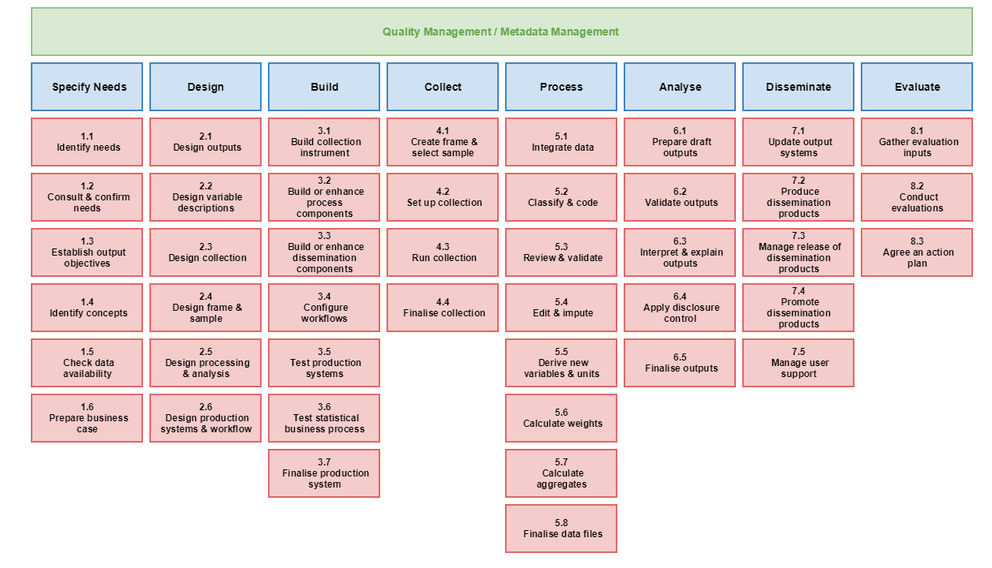
Map for our pilot phase:
Generic Statistical Business Process Model (GSBPM)
We finished the pilot phase for the external stats.

Slide 4



SDMX Model Implementation– External Sector
DSD
Send/Upload estandarized data
(“push model”)
Codification and model
Conversion
Generate self queries (“pull model”)
input
SDMX File
3 dataflows
3 dataflows in ML Format
BOP
IIP
EXD
Adjustments

Slide 5
SDMX Model Implementation– External Sector
Selected Tools
I. Modelling the data: Excel/SAS
II. Conversion: Java SDMX Converter (SDMX.org) Catching up opportunities
III. Queries and visualizations: MS Power Bi

Slide 6
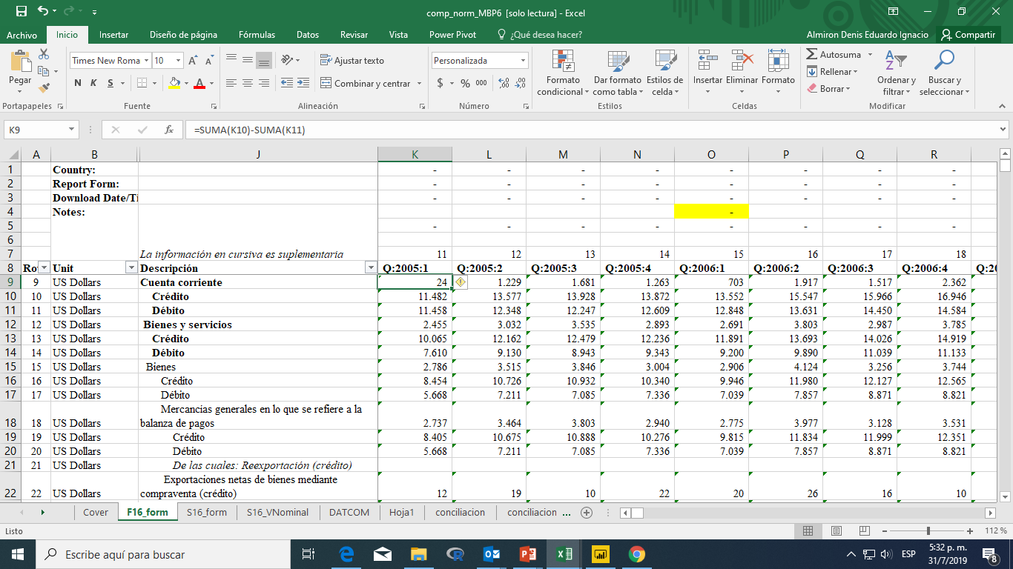

I. Codification and model of the data
Original working file
We start from a normalized components table: category/Period format xls file

Slide 7
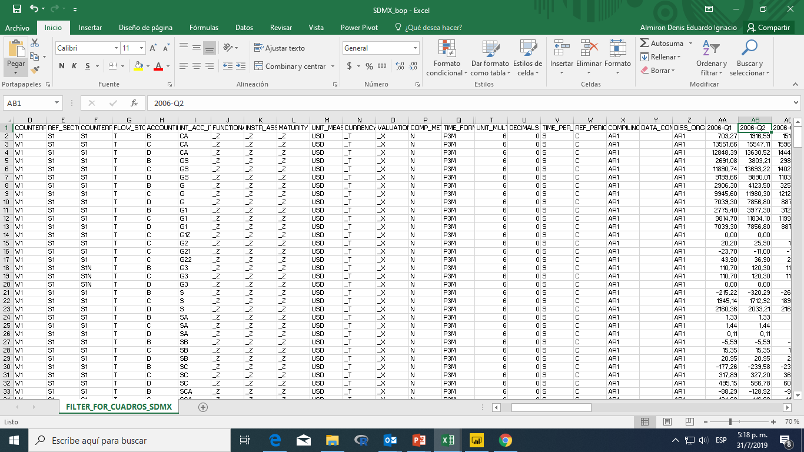
Codification and modelling of the data
Observations
Dimensions
Ordered information for the SDMX model
Ej: SDMX Code - Q.N.AR.W1.S1.S1.T.B.CA._Z._Z._Z.USD._T._X.N
16 dimensions that describe each observation + attributes.

Slide 8
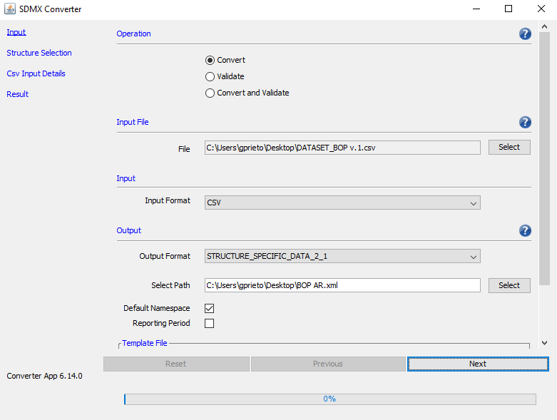
II. Conversion
a) SDMX converter – INPUT DATASET

Slide 9
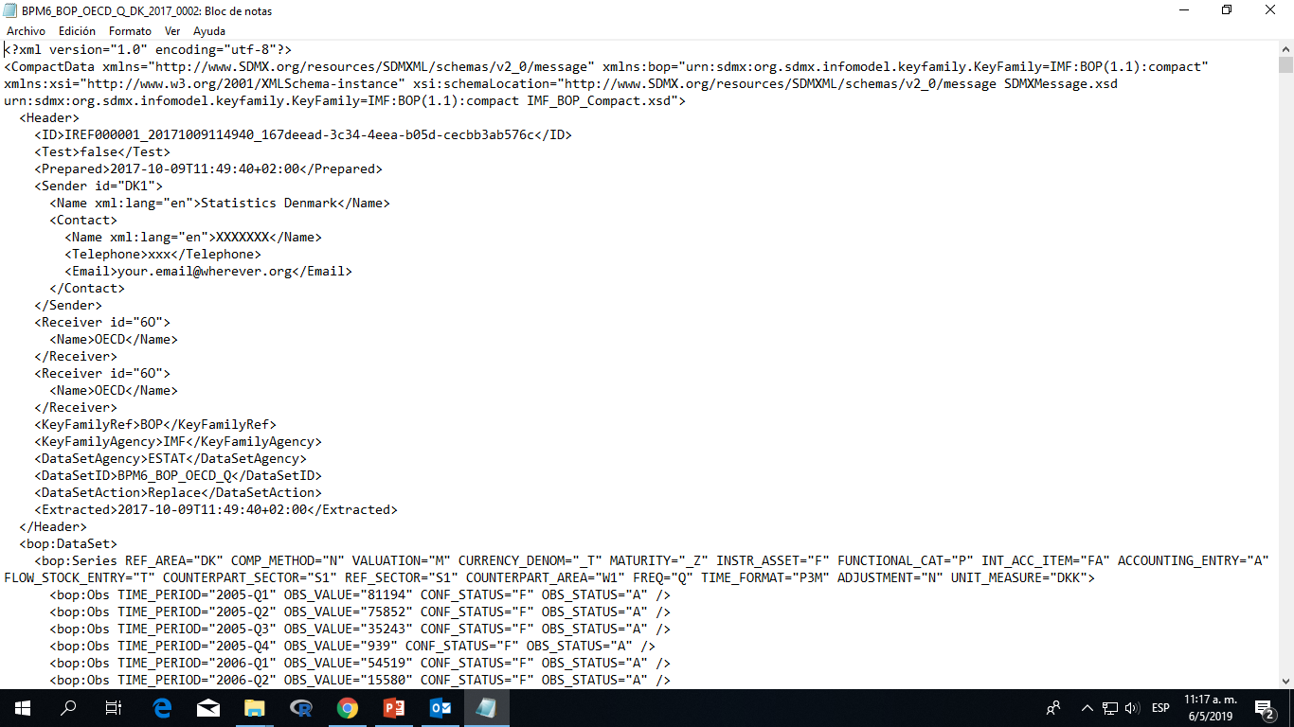
Output: SDMX Media Library File
Exchange format:
SDMX-ML
Metadata + data together
dimensions
Period + observation + attributes

Slide 10
XML Format vs Excel - Pros
XML improves the amount of data that may be available.
Any XML is usually richer in metadata than HTML or PDF.
SDMX offers an XML format that allows data to be accompanied by corresponding metadata.
The data is surrounded by tags that facilitate the understanding of the data and metadata.
The concepts used to describe and identify the data are shown explicitly (DSDs).
The code lists used to identify the data and surround them with their corresponding metadata are provided to the user.

Slide 11
Utilities of the XML file
Upload of the XML file on the web
Output in XML format
(push model)
XML as input for self – managed reports / queries
(pull model)
Other:
Quick structural validation of data
Seasonal Adjustment or Forecasting using a big amount of data

Slide 12
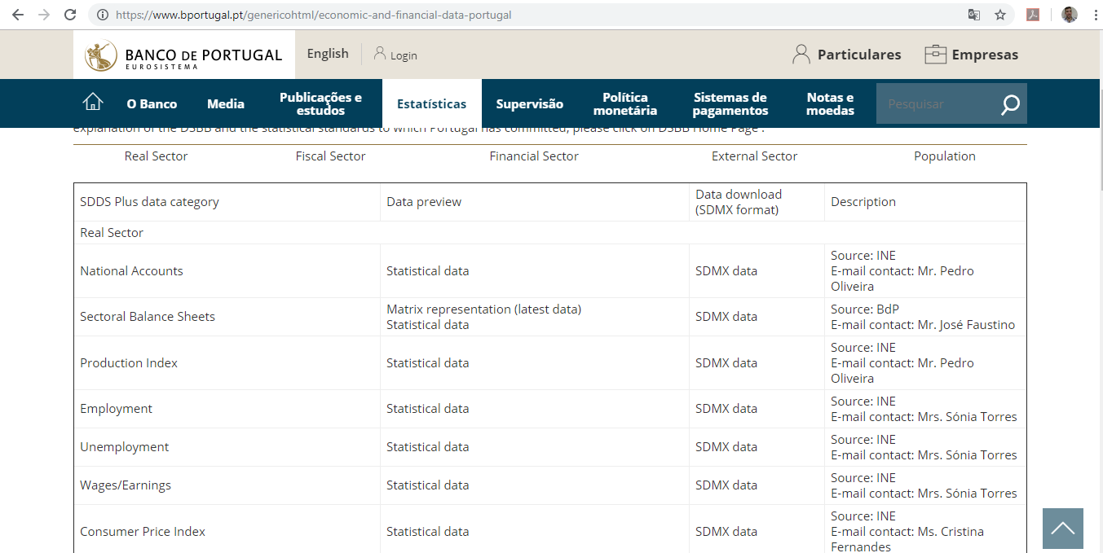
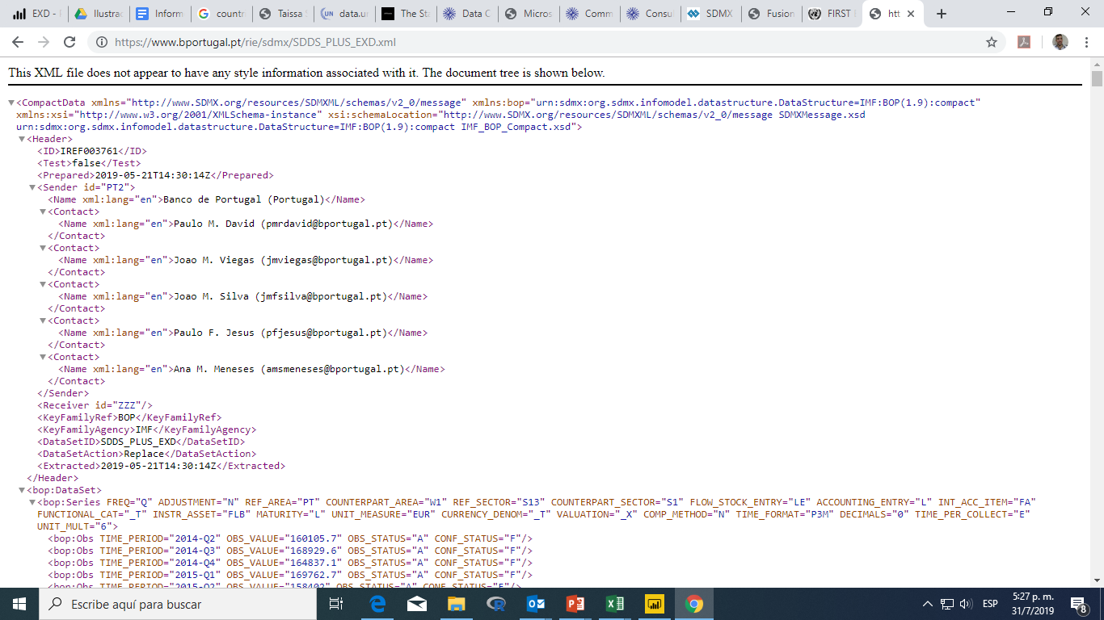
Uploading the xml output. Example
Push model
Portugal: https://www.bportugal.pt/genericohtml/economic-and-financial-data-portugal

Slide 13
Visualisation of the data
Current graphs are not standardized.
Most of the graphs are embedded in the technical reports, in pdf format.
The adoption of the new standard is an opportunity to homogenize the visualizations.
In this first phase (trial), we are using different software and testing their performance: Tableau & MS PowerBi.

Slide 14
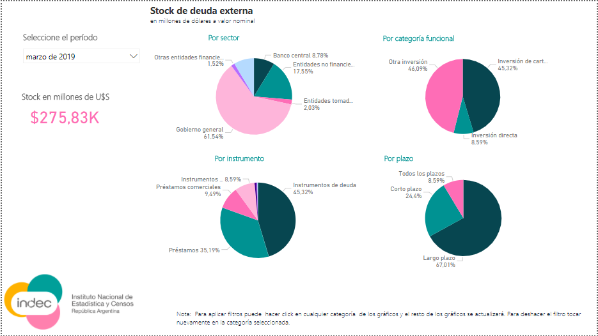
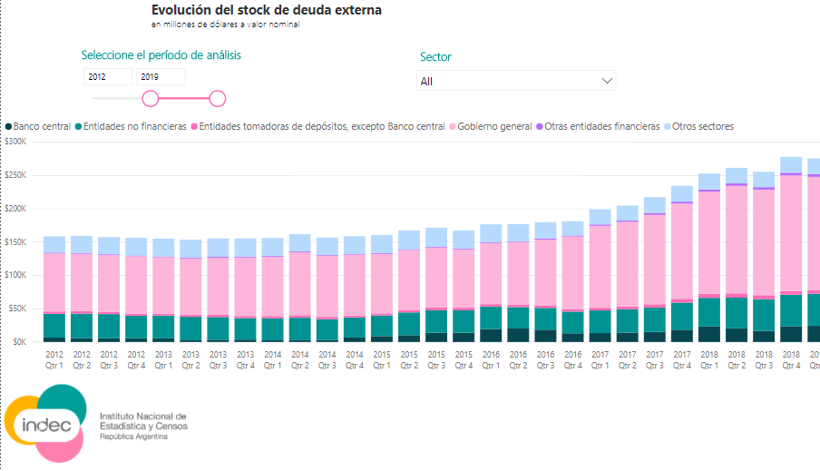
Pilot phase “pull model”:
Generation of self-managed reports
https://app.powerbi.com/view?r=eyJrIjoiMzg0YWQ0MTMtMzY0OC00NTQ2LTg0NTQtZmI0ZjVlOWE4ZmQxIiwidCI6IjE1OTk0YThhLTkxNGUtNGY4YS04Mzg1LTg3NjExNTY3MjRlOCIsImMiOjR9

Slide 15
What we had to overcome with?:
No country and few regional records in this matter
Coordinate an inter-area working group
Old habits. Antique ways of managing data
Catching up with SDMX Tools

Slide 16
Where are we?
Building a Working Group with analyst from other areas to implement the SDMX Model to other indicators (priority= Indicators included in SDDS).
Writing guidelines for other areas to convert the data to xml format under the SDMX model
We are about to publish the External Sector indicators in xml format under SDMX model (last week of September)
Developing visuals from SDMX inputs

Slide 17
Next steps:
Spill over to the rest of the institute and other data producers like Central Bank and Ministry of Economy and preach about the importance of the standard
Convert and upload more indicators in xml format under the SDMX standard
Continue, developing testing and publish visuals and online queries

Slide 18
Thank you for your attention!
¡Gracias por su ateción!

