Slide 1
Measuring the data universe:
A management perspective on data integration using SDMX
SDMX Global Conference , Budapest, September 2019
Dr. Patricia Staab, Statistical Information Management, Deutsche Bundesbank

Slide 2
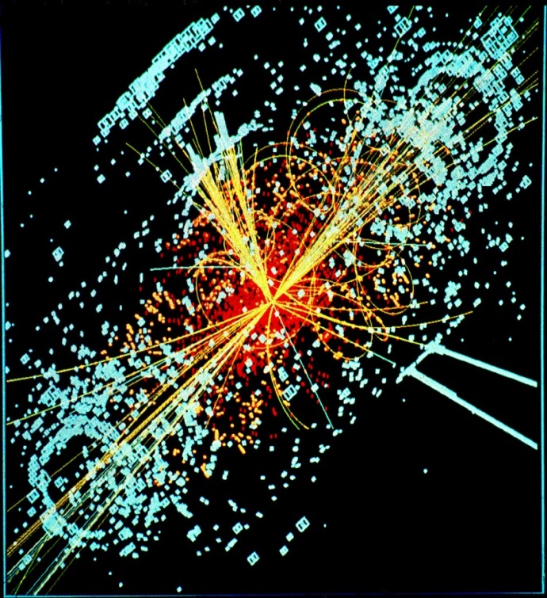
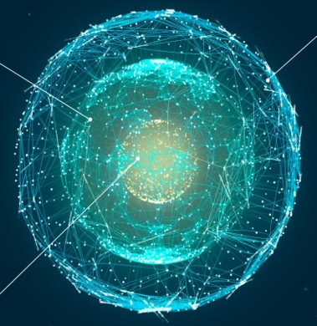
The data universe is exploding
Data amount is growing constantly and rapidly
  Automatic recording of process data (sensors, IoT)
  Social networks, smart phones and tablets
  Growing "numbermania“
  More computing power, new analysis techniques
However: „Data is not information…“ *)
  Yawning Data Gaps despite “Collectomania”
  Using IT not Possible Without Content-Related Expertise
  The Data Universe lacks Order
Source: www.stratio.com
Vision: A well ordered
map of the starry sky
of information
*) Data is not information, information is not knowledge,
knowledge is not understanding, understanding is not wisdom. – Clifford Stoll

Slide 3

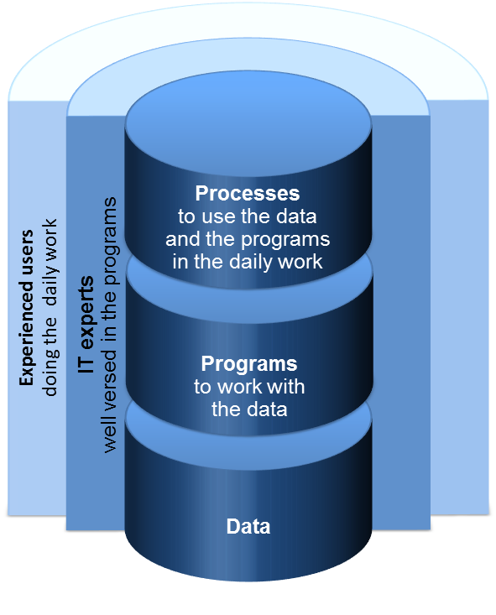

The approach so far: Moving towards an application driven architecture
Silo of
Data Science A
Silo of
BI Product C
Silo of
Data Science D
Silo of
BI Product A
Silo of
BI Product B
Silo of
Data Science C
Silo of
Data Science B
Source: R. Stahl, P. Staab, Measuring the Data Universe. Springer; 1st ed. 2018 (28. Mai 2018)

Slide 4
A different, data centric approach:
Integrating the data of high relevance
Coordination
Ontologies, Global IDs…
Standardization
SDMX, DDI…
Semantic harmonization
IT, Technology
DWH, BI Projects…
Uniform data
modeling method
Order system
The concepts, methods
and codelists used for the classification of the data
are the same.
Thus linking the data, the actual integration of content, becomes possible.
Logical
Centralization
A uniform language (the same concepts and terms) is used to describe the data.
Thus a rule-based (and automatable) treatment of the data becomes possible.
The data is stored (physically or virtually) in a common system.
Common procedures can be used for administration, authorization and access.
Increasing degree of standardization
Ready to be linked
Source: R. Stahl, P. Staab, Measuring the Data Universe. Springer; 1st ed. 2018 (28. Mai 2018)

Slide 5
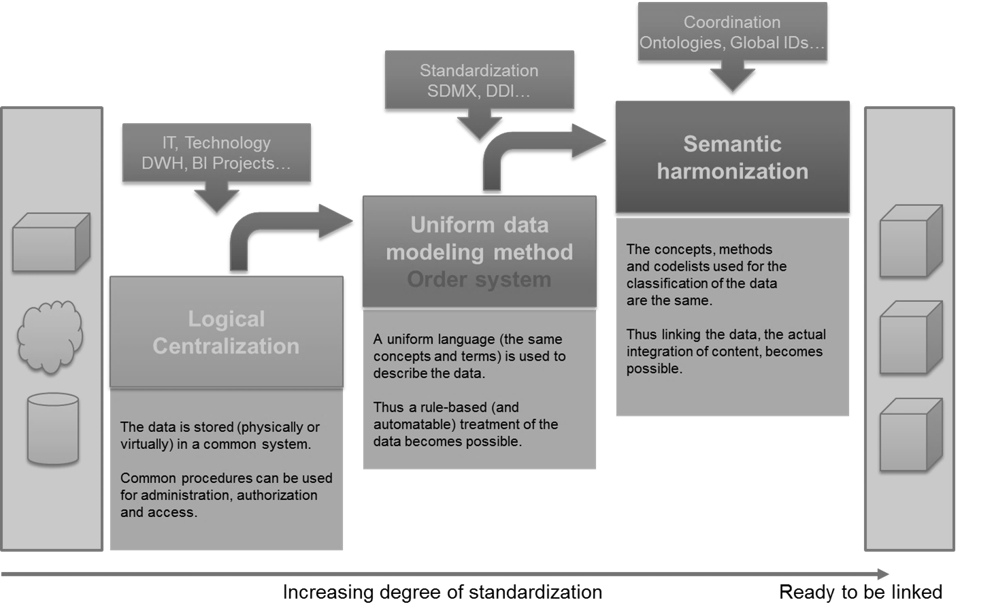


A different, data centric approach:
Integrating the data of high relevance
“intelligent”
Data Warehouse
“simple”
Data Warehouse
Data Lake
Source: R. Stahl, P. Staab, Measuring the Data Universe. Springer; 1st ed. 2018 (28. Mai 2018)

Slide 6

Bringing it all together:
Data and systems landscape
A beautiful house by the lake…
Source: https://de.wikipedia.org/wiki/Datei:EZB-Geb%C3%A4ude_in_Frankfurt_(Main).jpg

Slide 7









Bringing it all together:
Data and systems landscape
Data Warehouse
eg Bundesbank
House of micro data
“Casual
users”
Raw data from internal systems
Standardization
eg SDMX
Business
analysts
Data Lake
Big Data applications, advanced analytics
External data sources
Data science,
research
Company Data Center

Slide 8
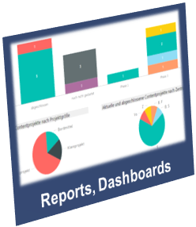
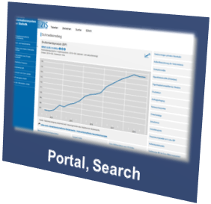
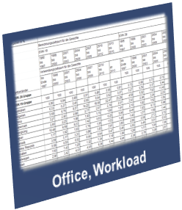
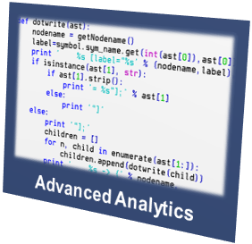
Example:
Deutsche Bundesbank Central Statistics Infrastructure
Bundesbank Central Statistics Infrastructure
  Data Content (February 2019)
  160 mio time series (150 mio internal)
  in 450 data sets (210 internal)
  Integration Pipeline for House of Microdata in 2019
  ESCB Centralised Securities Data Base:
  350 mio time series
  German Securities holdings statistics:
  12 mio time series
  Other
  Over 1.500 active users
  of which 200 per day
  10.000 downloads per day
  1 mio time series downloaded per day
Multiple sources (statistics, supervision, markets, cash,…)
International organisations, commercial data
Bundesbank House of Microdata

Slide 9
SDMX for Microdata - Experiences of ECB & Bundesbank

Slide 10
Workstream “SDMX for Microdata” from the
SDMX Roadmap 2020
Resulting document: Design of data structure definitions for microdata – Report of Experiences from the European Central Bank and Deutsche Bundesbank
General challenges of Microdata (Volume, Confidentiality, Master Data, Reference Metadata, Back Data Revision Mechanisms)
DSD specific challenges (Multiple Measures, un-coded concepts, exploding code lists, groups)
DSD Design Principles for Microdata (keeping the same approach as for macrodata, balancing number of DSDs regarding optimum fit vs. redundancy and integrity)
Easy-To-Use Formats (especially SDMX-CSV, SDMX-JSON)
Use Cases (Bundesbank House of Microdata, AnaCredit)

Slide 11
Example 1: Use Case “House of Microdata”
Money Market Statistical Reporting
Key dimensions
Frequency
Reporting
agent
Market
segment
Reference
date
Transaction
identifier
describe
Money Market Statistical Reporting
Measure | Nominal amount of the transaction
Attributes | Around 25 attributes with detailed information on the transaction E.g. interest rate, Proprietary Transaction Identifier (PTI), Legal Entity Identifier of the counterparty (LEI), maturity

Slide 12
Example 2: Use Case “AnaCredit” (Collection of microdata on credits on a loan-by-loan basis from Euro NCBs)
BBK Internal
BI-System
SDMX-CSV
Reporting Agent
BBK AnaCredit
ECB AnaCredit
SDMX-ML
(Flat format)
SDMX-ML
(Flat format)
ECB uses the SDMX 2.1 flat format (where all dimensions appear at observation level)
Bundesbank follows this approach for the domestic Bank‘s primary reporting without using a DSD
→reporting agents can manage their reporting obligations without having to handle SDMX concepts
for internal interface to the BI Systems use of SDMX-CSV format

