Slide 1
Planning and implementing a public SDMX service

Slide 2
NORGES BANK IN 30 SECONDS
Norges Bank’s mission is to promote economic stability and manage substantial assets on behalf of the Norwegian people.
The Bank conducts monetary policy, monitors the stability of the financial system and promotes robust and efficient payment systems and financial markets.
  The operational target of monetary policy is low and stable inflation, with annual consumer price inflation of close to 2.0% over time.
  As part of its work to promote stability in the financial system, the Bank has been assigned responsibility for preparing a decision basis and providing advice to the Ministry of Finance regarding the level of the countercyclical capital buffer requirement imposed on banks.
Norges Bank is responsible for the management of Norway’s foreign exchange reserves and the management of the Government Pension Fund Global (GPFG) on behalf of the government
Notes:
Employees 953
Employees, Norges Bank Central Banking Operations 345
Employees, Norges Bank Investment Management 601
The Oil funds market value: 9600 billion NOK
About data management:
Data Management (DM) is responsible for managing data in Norges Bank. DM must be able to handle the users' data needs in an efficient and secure manner. DM shall be able to meet requests from users within a reasonable time limit. In order to minimize operational risk, DM must possess relevant and sufficient expertise in statistics, programming and IT.
Part of IT
Not a big organisation:
Internal
6 data managers
1 solution architect
1 system mgr/developer
1 team leader
External
3 developers
1 release manager

Slide 3
AGENDA
Norges Bank in 30 seconds
Project background
Lessons learned planning, implementing and operating a public SDMX service
The way forward for the service
Notes:
Describe the topic and how I address it

Slide 4
WHAT DID WE TRY TO SOLVE?
Strategically
Norges Bank has a goal of being an «open and accessible» central bank.
..translates to
Offer relevant data in relevant formats to market actors, institutions and the general public.
..however
Limited and heterogeneous publishing standards, formats and processes hinder this goal
The goal of the Data Market project is to provide a solution for Norges Bank to offer the public open data over standard electronic distribution channels in standardized formats.
Notes:
Relates to how we publish statistics in som very concrete ways:
How much
In what formats, suitable
How fast
We would LIKE to say that it was driven by strategy but it was more of a technical necessity being interpreted in a strategic perspective
IT driven project

Slide 5
From siloed publishing processes and static formats..
..to a service anyone can query and request data in a suitable format
Web
Institutions
Everyone
Request data in suitable format
Data market
Data market offers data through a service
Standard publishing mechanism
Internal data
Internal data

Slide 6
KEY DECISIONS
Restricted data will never touch the service. |  | Lowered the barrier to get the project implemented.
“Eat our own dogfood” -> Prove the API by letting our web pages use it. |  | Provided a robust quality assurance mechanism but also made the project more complex.
Must be manageable by our infra- and application management partners. |  | Use standards and shelf ware with support where possible. Involve partners early on.

Slide 7
WHY DID WE CHOOSE SDMX?
Mature, well documented and adopted by similar institutions.
Both «nuts and bolts» and concepts already available
Internal competence suggested it would fit our requirements quite well.
Notes:
There are quite a few national and international standards to choose from

Slide 8
KEY DELIVERABLES
Publication of our most used datasets to the API (interest- and exchange rates) which required:
A generic web API for querying Norges Bank public datasets.
A publishing component that moves data from our source systems to the API.
A mechanism to ensure the integrity of the data we publish.
Related web pages to be sourced from the API rather than the legacy publishing processes.
A support organization.
Consumers
SDMX REST API
Validation component
SDMX meta- and data store
SDMX publisher (Fame2SDMX)
Internal data store (Fame)

Slide 9
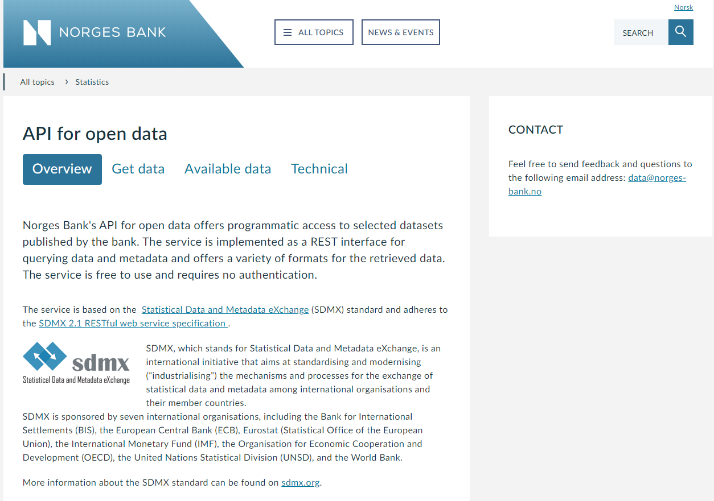
DELIVERABLE 1: THE API
Notes:
Shamelessy stolen from the ECB

Slide 10
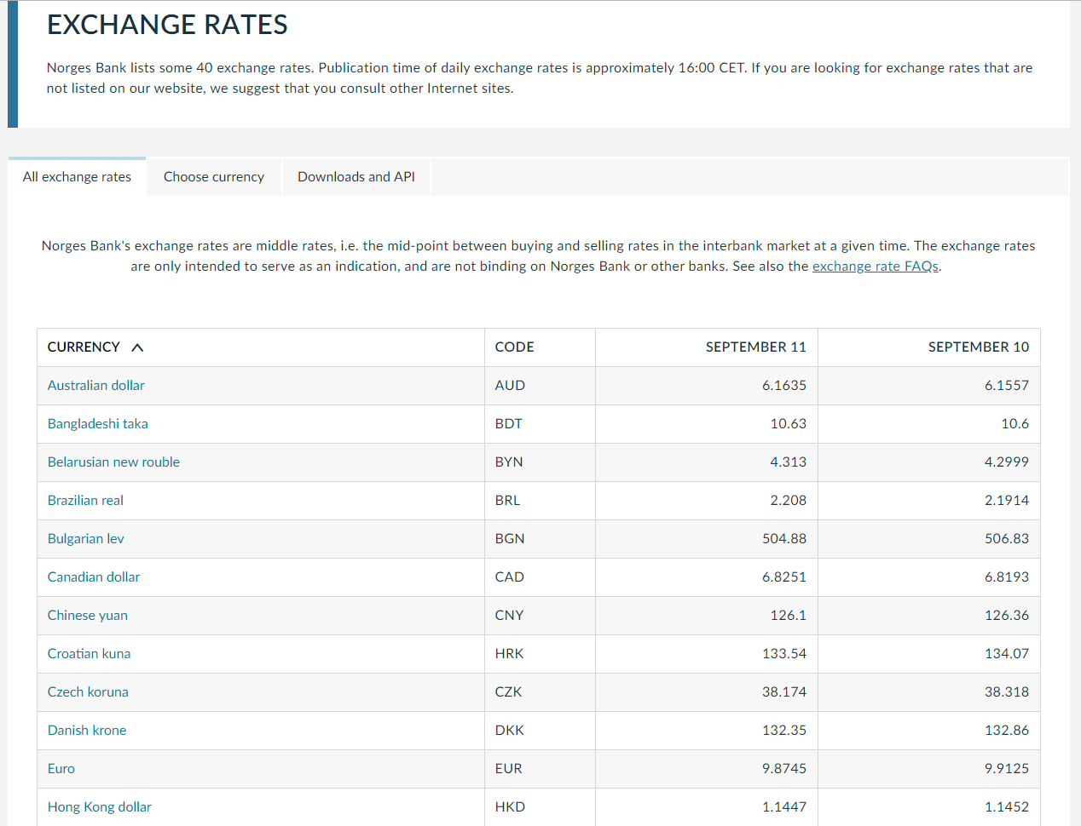
DELIVERABLE 2: Migrated pages

Slide 11
LESSONS IMPLEMENTATION
Understanding SDMX in a pure dissemination perspective takes some time.
Creating robust Data Structure Definitions is challenging, especially if SDMX is implemented as an IT initiative.
Leaning on a standard greatly simplifies vendor interactions.
Even though we had a quite narrow scope the diverse technologies, cross-functional participation and finding the skillsets required to implement the solution was challenging.

Slide 12
LESSONS POST IMPLEMENTATION
The momentum SDMX gained should be better exploited by immediately starting migration of remaining legacy publications after delivery.
Leaning on a standard greatly simplifies interactions and communications with internal and external stakeholders.
Having the IM and AM partners directly involved in the project greatly eased the transition into operations.
The public has quite simple needs.

Slide 13
STATS FOR 04 SEPT 2019
16 465 Unique users
167 160 Requests
Requested formats (excluding json)
Unique users since launch

Slide 14
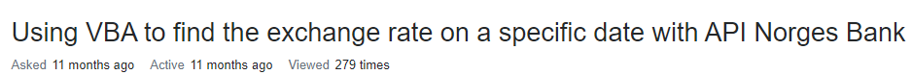
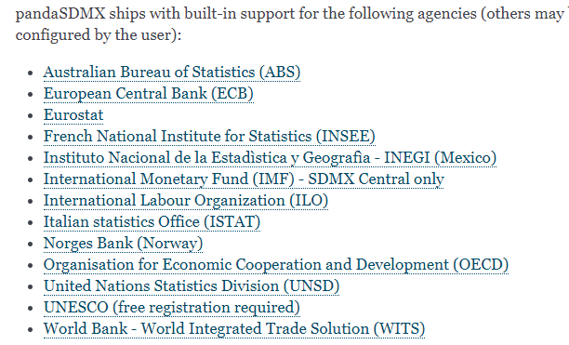

Slide 15
WAY FORWARD
Make SDMX mandatory for new publications
Migrate legacy publications
Support new publishing scenarios:
  Time sensitive publications
  Non time-series publications
Evaluate SDMX as a model for our internal time series metadata

