Slide 1

Data visualisation using an
SDMX-based time series model
Ioana Trainotti
ECB
DG-Statistics
SDMX Global Conference
16-19 September 2019

Slide 2
Overview
Data visualisation using an SDMX-based time series model
1
Reports, visualisations and SDMX
2
Visualisations landscape
3
Reports and visualisations solutions without SDMX
4
Drawbacks and Issues
5
Reporting and visualisations solutions with SDMX
6
Advantages
7
Lessons learned
Data visualisation using SDMX

Slide 3
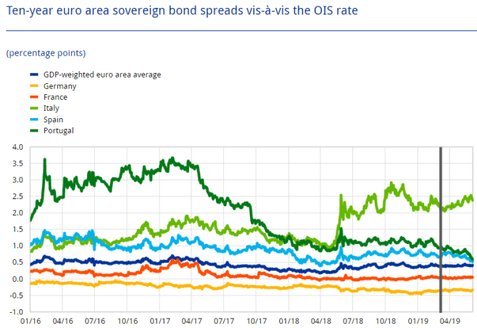
Reports, visualisations and SDMX
'A picture is worth
ten thousand words'
Text
Text
Text
Text
Text
Text
Text
Text
Text
Text
Text
Text
Text
Text
Text
Text
Text
Text
Text
Text
Text
Text
Text
Text
Text
Text
Text
Text
Text
Text
Text
Text
Text
Text
Text
Text
Text
Text
Text
Text
Text
Text
Text
Text
Reports and
visualisations
are the key
to obtain value from data
ECB
Economic Bulletin
'A good sketch is
better than a longspeech'
Visualisations
require
understanding
our data
Turn raw information
into relevant story for
decision-making
“… deeper insight into the
ECB’s activities … to explain the background to some of its decisions”
Regular decision making implies standardisation
Data visualisation using SDMX

Slide 4
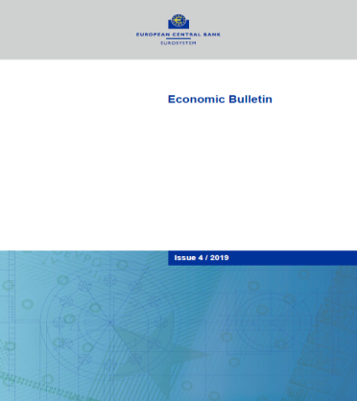
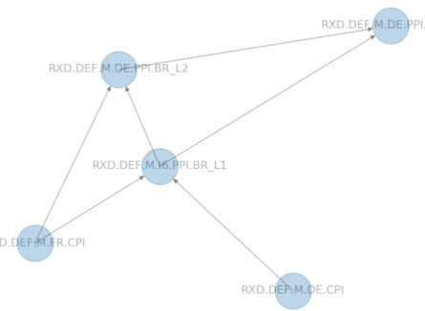
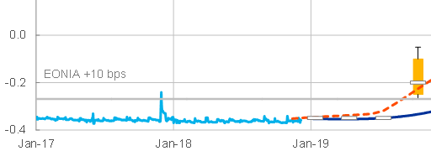
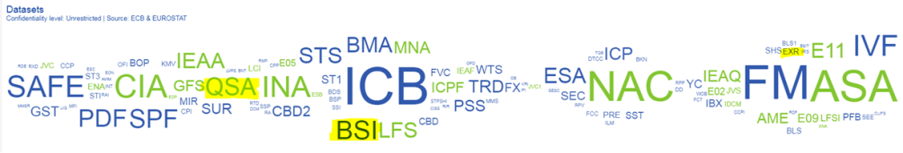
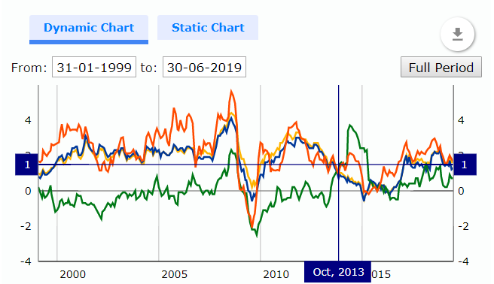
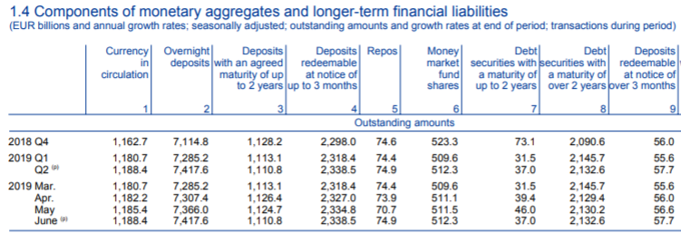
Visualisations landscape
Landscape is complex, manifold and multi-purpose
Publications
Static reports Dynamic reports Interactive reports
Data visualisation using SDMX

Slide 5

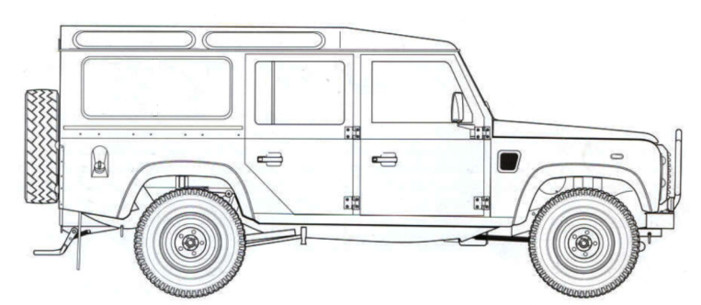


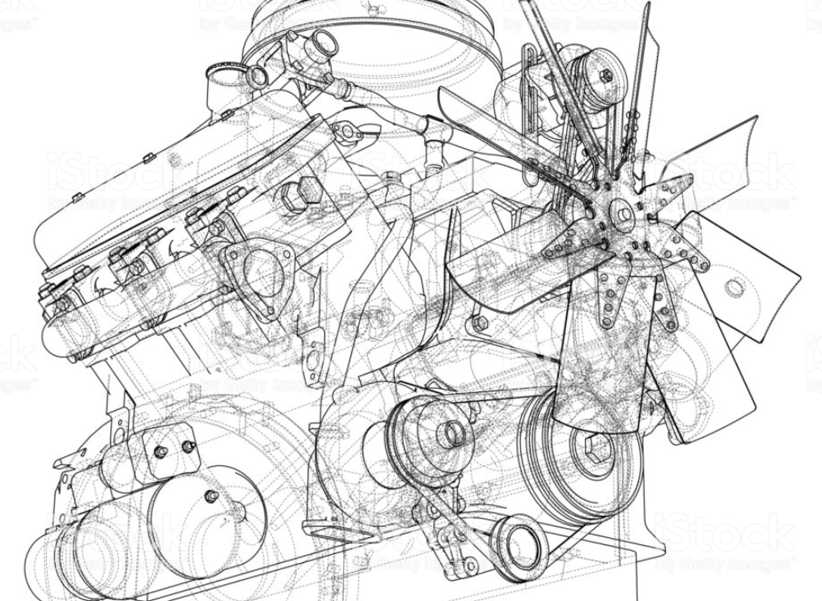
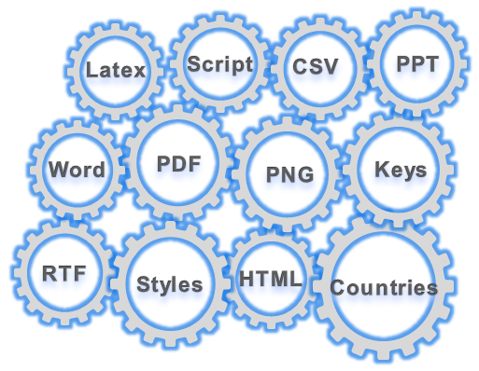

Reports and visualisations solutions without SDMX
Production Day
Submit interface
ESCB, IOs
Excel Pivot Tables
Excel/CSV
Uploader (VB)
R
Markdown
The public
Excel Populator
ORACLE link (Java)
R/CRAN
ECB
Tableau
Tableau Web Data
Connector
Data visualisation using SDMX

Slide 6







Drawbacks and issues
Different tools used for static, interactive
Hard to maintain reporting templates
Extra layers of implementation
Duplication of metadata
Difficult metadata-driven search
Silo system Proprietary technology
Data visualisation using SDMX

Slide 7
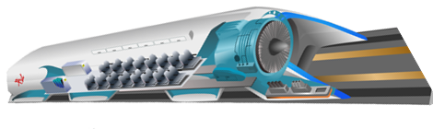




Reporting and visualisations solutions with SDMX
Reports and Visualisations engine
ESCB, IOs
Common Reporting Framework
Registry
Common modules
ECB
Integrated with
Information Model
Common data access layer
The public
Data visualisation using SDMX
Data visualisation using SDMX

Slide 8
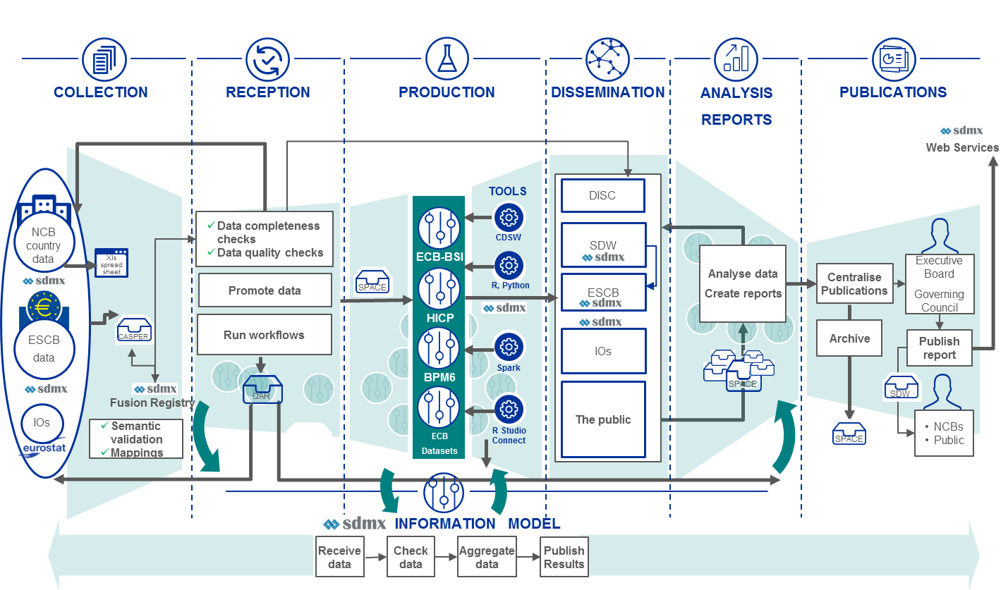
High-level process
Reporting and visualisations solutions with SDMX
Data visualisation using SDMX

Slide 9
Advantages
What did we gain with this approach ?
SDMX information model for easier data preparation
Use SDMX metadata-driven search
A unified toolbox to produce reports and visualise data
Use common functions across business areas
Use of leading-edge technologies
Data visualisation using SDMX

Slide 10

What have we learned ?
Lessons learned
The use of the SDMX information model facilitates technical harmonisation and fosters data integration
Common library: sometimes less is more
We need horizontal scalability for higher data volumes
Reports and data visualisations can share tools
Data visualisation using SDMX

Slide 11


Q&A
Data visualisation using SDMX

