Slide 1
Evolution of the SDMX standard: Results of the public consultation
2019 SDMX Global Conference, 17. September 2019

Slide 2
The case for a new version of SDMX
Micro data
Geospatial

Slide 3
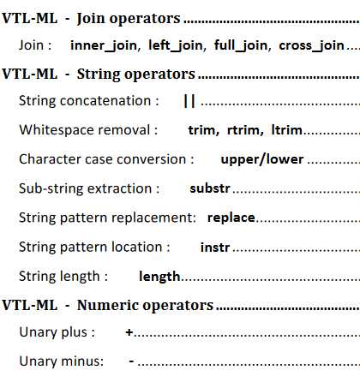
The case for a new version of SDMX
Validation and Transformation Language
COMPLETED
(VTL 2.0, released in July 2018)
Integration in the SDMX Information Model needed!

Slide 4
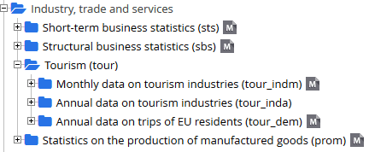
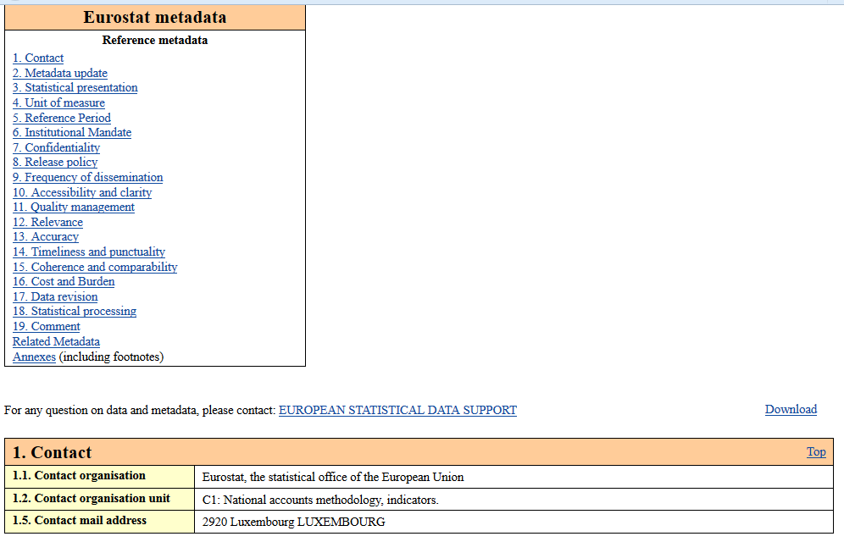
The case for a new version of SDMX
For every dataset…
…harmonised metadata

Slide 5
The case for a new version of SDMX
Me
Our code lists
Sometimes managing SDMX objects feels a bit like herding cats…

Slide 6
SDMX 3.0 Prioritisation exercise - stakeholders
The SDMX technical and statistical working groups identified 23 features to be considered for the next release of the standard (SDMX 3.0).
This proposal was put forward to the SDMX stakeholders
Sponsor organisations
SDMX Community at large
All seven sponsor organisations participated in the priority exercise
Data was compiled by the SDMX Secretariat
Public consultation was carried out over 8 weeks on sdmx.org
29 respondents submitted their preferences
Data was compiled by the SDMX Secretariat

Slide 7
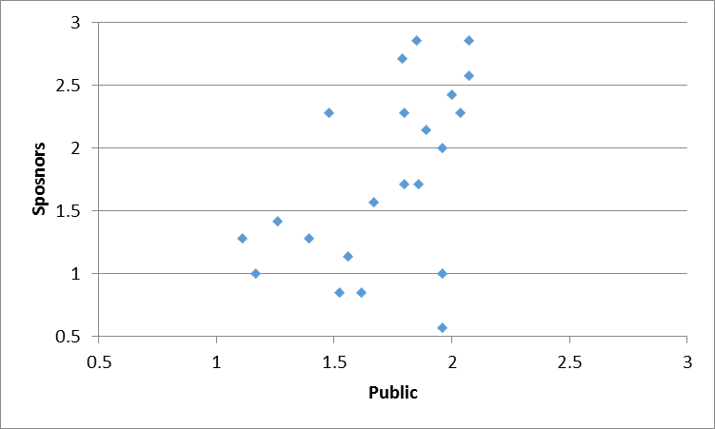
SDMX 3.0 consultation results
1 feature rated "Helpful" by the Sponsors only
4 features rated "Very helpful" by both stakeholder groups
8 features rated "Helpful" by both stakeholder groups
5 features rated "Helpful" by the community only

Slide 8
SDMX 3.0 public consultation: Top Picks
Improvements to Codelist design and maintenance
Enable data validation and transformations
Versioning and management of artefacts made easier
Enhance data queries
Improve the exchnage of reference metadata
Support reference metadata in the restful API
Support microdata exchange
Next steps: SDMX Sponsors will analyse the results and decide on the scope and timeline for SDMX 3.0.

Slide 9
Impact
Monocentric
SDMX was originally built to address the needs of international data exchange
Polycentric
SDMX would address use cases that make the standard more attractive for data providers beyond simple reporting (and for other stakeholders as well!)
SDMX Sponsor agencies
National central banks
National statistics offices
SDMX Sponsor agencies
National central banks
National statistics office

Slide 10
Impact
SDMX 3.0 opens some questions on the future of the community.
What is the core business of SDMX? Should we focus as before on Official Statistics, or should we try to branch out towards other communities (research institutes, universities, private sector etc.)?
How do we support the growing community and the deeper use at national level which we are likely to see with SDMX 3.0?

Slide 11
Thank you for your attention!

