Slide 1
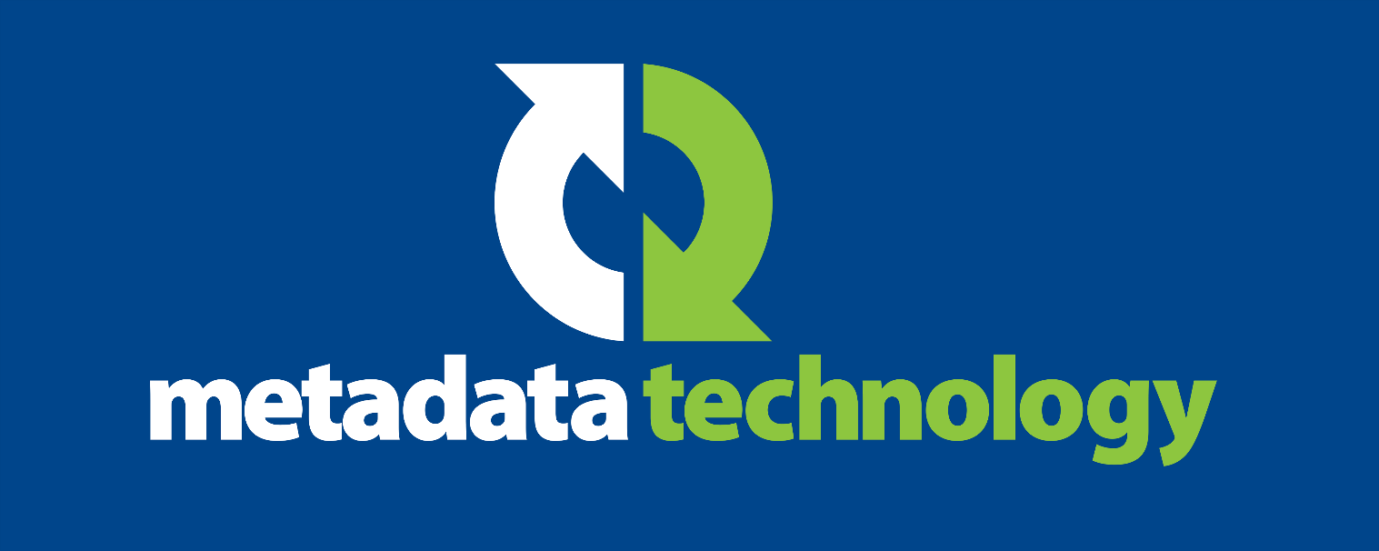
Delivering Benefits for the SDMX Community by Improving Adoption of SDMX in the Private Sector
Glenn Tice
September 2019

Slide 2

SDMX has seen limited adoption by the private sector
Why?
Case study
3 ideas for improving take-up
Benefits for the SDMX Community
Conclusion
metadatatechnology.com

Slide 3
Why?
Invisible outside of official statistics
metadatatechnology.com

Slide 4
SDMX can satisfy private sector use cases
Human Resources
Finance
Department
Reported
Statistics
Business Analytics and Insight Department
Marketing
Manufacturing
Logistics
metadatatechnology.com

Slide 5
Case Study
UK construction surveyors’ professional body wanted:
Proven standard to model and disseminate Construction and Property Measurement Standards
Non-proprietary international standard
SDMX structural metadata capable of modelling their standards information
API for dissemination
SDMX Sponsors
SDMX attractive
because…
metadatatechnology.com

Slide 6
Case Study
UK construction surveyors’ professional body
Build information model using SDMX structural metadata
Deploy SDMX Registry to disseminate metadata via the REST API
Use SDMX reference metadata to add additional descriptive content
How would SDMX be implemented?
metadatatechnology.com

Slide 7
3 ideas for improving private sector take-up of SDMX
1
Marketing
Capitalise on SDMX’s pedigree and proven track record
metadatatechnology.com

Slide 8
3 ideas for improving private sector take-up of SDMX
2
Make SDMX data easier to consume
SDMX CSV – easier to use than XML or EDI
SDMX JSON – data and metadata together
SQL interface to SDMX data sources
metadatatechnology.com

Slide 9
3 ideas for improving private sector take-up of SDMX
3
SDMX support for micro-data
Many private sector use cases need a solution for the entire data life-cycle
metadatatechnology.com

Slide 10
Benefits for the SDMX Community
Bigger market
larger selection of SDMX software tools
more innovation
economies of scale
Wider understanding of SDMX
bigger audience for SDMX data services
larger talent pool
potential investment from Google et al.
What’s the benefit?
metadatatechnology.com

Slide 11
Conclusion
Nothing fundamental stopping private sector organisations from using SDMX.
Could be attractive to many – if they knew about it.
SDMX Community Benefits…
Greater
private sector interest
Private sector investment
More tools, talent and users
metadatatechnology.com

Slide 12
SDMX Software | Consultancy | Training
metadatatechnology.com

