Slide 1
Practical experiences with implementation of SDMX for granular AnaCredit reporting across Eurozone for financial institutions and central banks
http://reg.tech
Prepared by: Gaurav Sachdeva
Budapest, September 2019

Slide 2
    RegTech & SupTech @ BearingPoint
1
    About AnaCredit & Exemplary use cases with SDMX
2
    Lessons learnt from SDMX & AnaCredit & Observations for the future
3

Slide 3
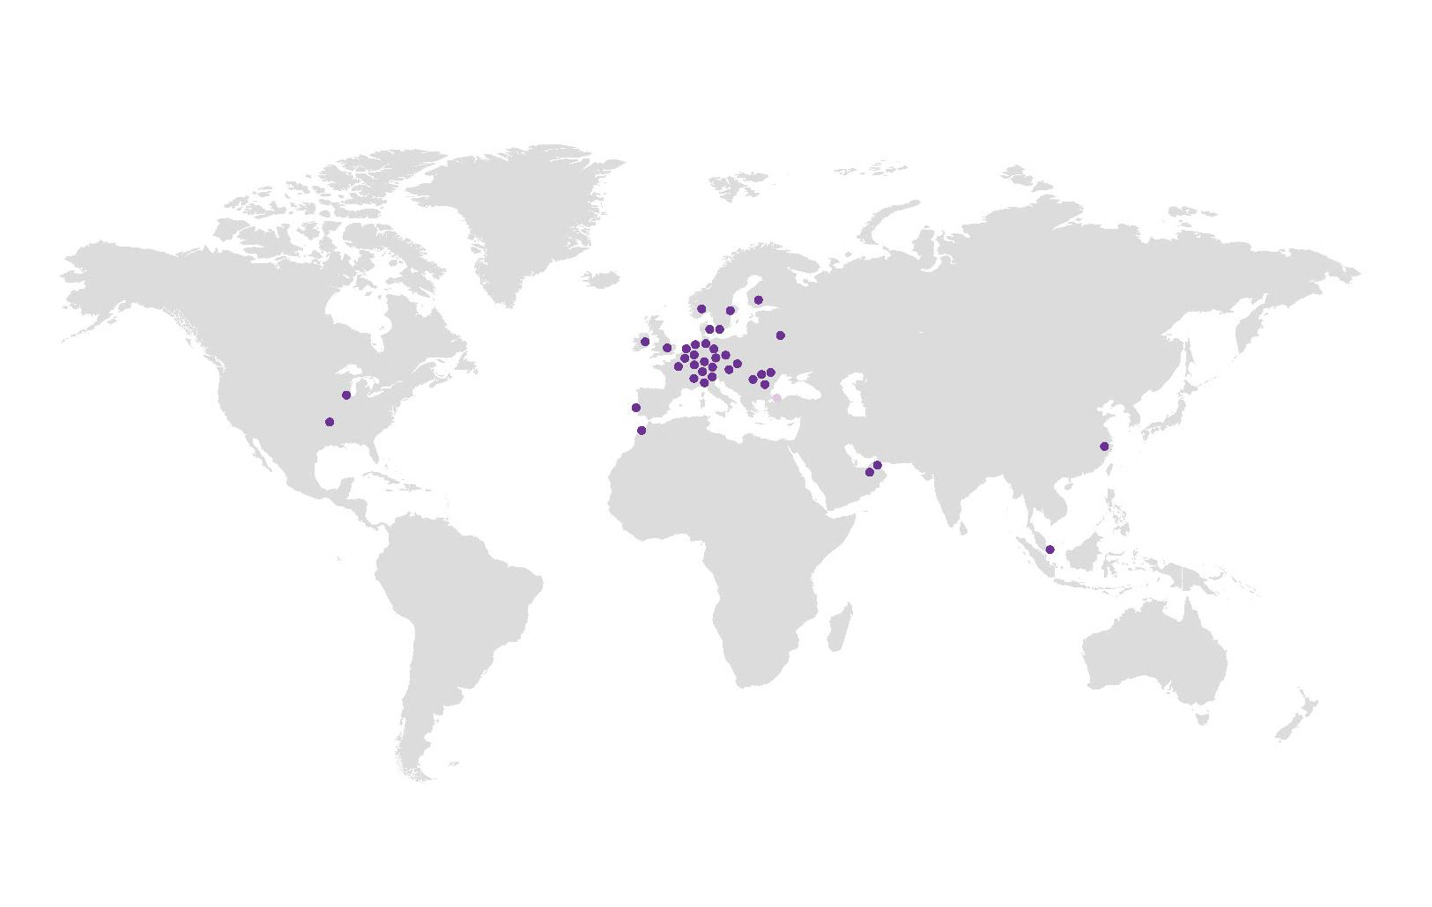



RegTech & SupTech @ BearingPoint
Regulatory competence and global presence
6,000+
firms reporting
with RegTech
22
600+
RegTech & SupTech
professionals
Countries with direct
presence through
BearingPoint
>95%
RegTech & SupTech
customer retention
150+
Firms on BearingPoint RaaS (Regulatory-as-a-Service)
Central banks collect data of 3,000+
firms with
SupTech
2,550+
Firms reporting
with Abacus
1,200+
Financial Service Professionals

Slide 4
    RegTech & SupTech @ BearingPoint
1
    About AnaCredit & Exemplary use cases with SDMX
2
    Lessons learnt from SDMX & AnaCredit
3

Slide 5










General Architectural Approach for AnaCredit International Development
Separation of ECB Standard allows flexible development of additional countries
Reporting Layer
Specific reporting formats, e.g. XML, CSV SDMX…
Granular Reporting
Visibility Context for national data requirements
Prudential Reporting
Statistical Reporting
Ad-hoc Reporting
AnaCredit SP
Modules
AnaCredit IT
AnaCredit NL
AnaCredit core module
ECB standards
AnaCredit FR
AnaCredit IE
AnaCredit LU
AnaCredit DE
Data
Abacus 360
Datamodel
Source systems

Slide 6
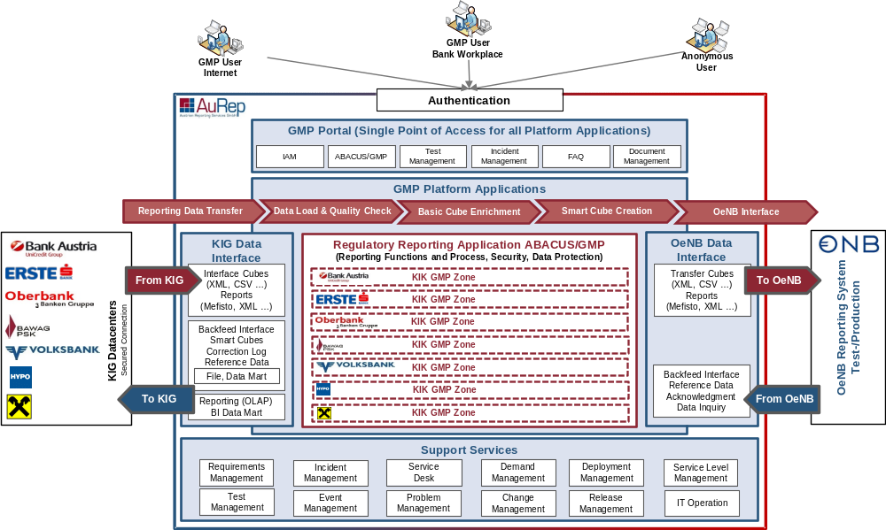
Our experience with largest data factory collecting and remitting granular data
”ABACUS/GMP is still being rolled out, but the signs are positive so far. It works, it really works” Johannes Turner, director of statistics at the National Bank of Austria (December 2015)
“… regulators still struggle with legacy systems, and the pace of reporting and monitoring modernization … is often behind where it needs to be given the rate of growth with notable exceptions”, G20 Global Partnership for Financial Inclusion
  Approximately 1200
  registered GMP users
  All major Austrian banking
  groups (over 1000 MFI with
  target for 1400)
  2 000 000 000 granular
  data sets per date
  (loans, securities, counterparties)
  18 000 files per month
© 2016 Austrian Reporting Services GmbH
All rights reserved. The name AuRep and Logo are registered trademarks.

Slide 7




Our experience with central banks collecting and remitting AnaCredit in SDMX
A fully integrated solution for data collection, regulatory analytics and remittance to the ECB
Reporting agents
Abacus Regulator
Statistical Processes
Data loading
Schema validations
Import
Counterparty
check
Non-schema validations
Analytics
Feedback loop
SDMX
ECB AnaCredit with national extension
SDMX,
Notes:
Productive since 2018
Regulation: ECB AnaCredit incl. RIAD interface

Slide 8
    RegTech & SupTech @ BearingPoint
1
    About AnaCredit & Exemplary use cases with SDMX
2
    Lessons learnt from SDMX & AnaCredit & Observations for the future
3

Slide 9
Practical Applicability
Banks & Financial
Institutions
National Competent
Authorities
*
*
Validation
*
Validation
31.12.18
Submission SDMX
31.12.18
Submission SDMX
31.12.18
Feedback
Feedback
Calculate delta
*
Validation
Validation
*
Submission SDMX
31.01.19
Submission SDMX
31.01.19
*
31.01.19
Feedback
Feedback
Calculate delta
Validation
Validation
28.02.19
Submission SDMX
28.02.19
Submission SDMX
28.02.19
Feedback
Feedback
* Correction in dynamic data marts (financial record)
Notes:
Initial Submission
Explain the submission chain of AnaCredit
Banks collects data from different legal entities, calculate & aggregate data, validate and checks consistency, then sends it to regulator
NCAs check data then send it to ECB.
ECB checks data. If everything is fine we‘re now done.
If somewhere in the process it is validated that data is inconsistent feedback file is send back to bank via NCAs and client has to correct file and resubmit
Follow Up submission (31.01.19)
Description: Explain dynamic and static data marts
Prepare data
Compare to previous reporting date
Submission for the reporting date
Follow Up submission (28.02.19)
Description: Now in this submission financial record has been corrected by customer that were included in the last two submissions.
Submission for the current reporting date and all previous reporting dates (!). So one initial submission and two corrections. As AnaCredit is a granular data format corrections happen quite frequently, when you thing that data sets contain millions of records. 1% change in millions mean still a lot of changes.
That has to be handled by the clients and organized via processes and reviews to make it auditable. Mayor challange!
Current challange:
Amount of Feedback files cannot be handled by banks.
(Not all NCAs work inline with the Spec. E.g. BuBa ignored for quite some time the delete messages and calculated them by their own systems.)
(According to my understanding in Ireland correction messages for older reporting dates are not required)
Data from the NCA, ECB level can get out of sync with the one from banks. There are in most no mechanisms to bring them back in sync without doing delta corrections which are even harder.
Not all NCAs have a separate AnaCredit submission (e.g. Netherlands) and includes this into their existing reportings or use different data formats than SDMX this is a real challange to have a harmonized cross border consistent data set.
Further reading: German Bundesbank Specification (also available in English): https://www.bundesbank.de/de/service/meldewesen/bankenstatistik/formate-xml

Slide 10

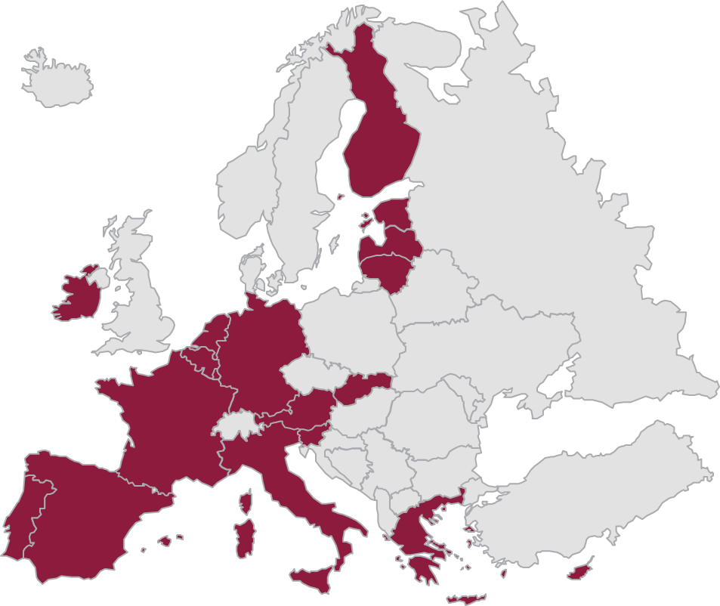

AnaCredit as central and national credit register for granular credit data
Overview
ECB credit register
ECB
NCB credit register
NCB 1
NCB 2
NCB ..
Bank x
Bank y
Bank…
Bank 1
Bank y
Bank…
Bank X
Bank Y
Bank...
With the resolution ECB/2014/6 (28th of February 2014), the NCBs in the EU member states were instructed to create legal preconditions in their countries to collect granular credit and credit risk data for statistical purposes for transmission to the ECB.
countries to collect granular credit and
Exchange of information among the members regarding the level of debt of borrowers.
The regulation on the collection of granular credit and credit risk data (ECB/2016/13) was officially published by ECB on 18 May 2016.

Slide 11


AnaCredit Lifecycle
First Submission
(Static + Dynmic data marts)
31.03.19
Re-submissions &
Feedback Handling
Amendments in validation rules
First Submission
(static data marts)
Reporting Date
30.09.18
1st productive data model
change (01.02.2020)
We are here
Preparation
Going live
Enter Maintenance Mode
Notes:
First submission: makes sure that the static data is collected and that it can be submitted
Clarification on different aspects like how to deal with delete messages, resubmissions, aktivation/deactivation/new validation rules
First full submission: also credit data is included now and therefor dynamic and static data is now in place.
Further occuring questions from the marktet (e.g. spaces in keys of certain records) and clarifications (e.g. no data for natural persons are allowed in the submission). Addition of new feedback from ECB validations and how that is handled.
Changes in data models (e.g. in Germany the new model applies

Slide 12

Few Observations…
Further Harmonization of regulation within EU
How to Synergize views between Regulators and Regulated Entities?
Provision of Standard Software is highly challanging in this environment
Reduce the burden for Regulated Entities
Notes:
First submission: makes sure that the static data is collected and that it can be submitted
Clarification on different aspects like how to deal with delete messages, resubmissions, aktivation/deactivation/new validation rules
First full submission: also credit data is included now and therefor dynamic and static data is now in place.
Further occuring questions from the marktet (e.g. spaces in keys of certain records) and clarifications (e.g. no data for natural persons are allowed in the submission). Addition of new feedback from ECB validations and how that is handled.
Changes in data models (e.g. in Germany the new model applies

Slide 13

Thank You for listening…
Gaurav Sachdeva
Head of International Business Development, RegTech Solutions
BearingPoint
Speicherstrasse 1
60327 Frankfurt
Germany
T +49 69 13022 1535
M +49 151 22052951
www.bearingpoint.com
gaurav.sachdeva@bearingpoint.com
Notes:
First submission: makes sure that the static data is collected and that it can be submitted
Clarification on different aspects like how to deal with delete messages, resubmissions, aktivation/deactivation/new validation rules
First full submission: also credit data is included now and therefor dynamic and static data is now in place.
Further occuring questions from the marktet (e.g. spaces in keys of certain records) and clarifications (e.g. no data for natural persons are allowed in the submission). Addition of new feedback from ECB validations and how that is handled.
Changes in data models (e.g. in Germany the new model applies

