Slide 1
SDMX Roadmap 2020:
Achievements, status and future outlook

Slide 2
2001
Birth of the SDMX initiative
2004
Release of the first version of SDMX
2013
SDMX published as an ISO standard
First release of global DSDs for National Accounts and Balance of Payments
2007
First SDMX Global Conference
2020
?
Notes:
The origins of the SDMX standard go back to 2001, when the 7 sponsor organisations joined forces to develop more efficient processes for the exchange and sharing of data.
The first fruits of this work came in 2004, when the first version of the SDMX standard was published. This was quickly followed by a second release in 2005.
The period between 2005 and 2010 represents the adolescence phase of SDMX: the Sponsors started using the standard for data exchange with their constituencies. At the same time, the technical knowledge and infrastructure which would form the basis for later expansion started being developed.
2011 to 2016 was the growth phase of the standard: it started being used as the backbone for several high-level data sharing and data integration projects, most importantly of all in the area of national Accounts, Balance of Payments and Foreign Direct Investment.
What are the goals for the evolution of the standard until 2020?

Slide 3
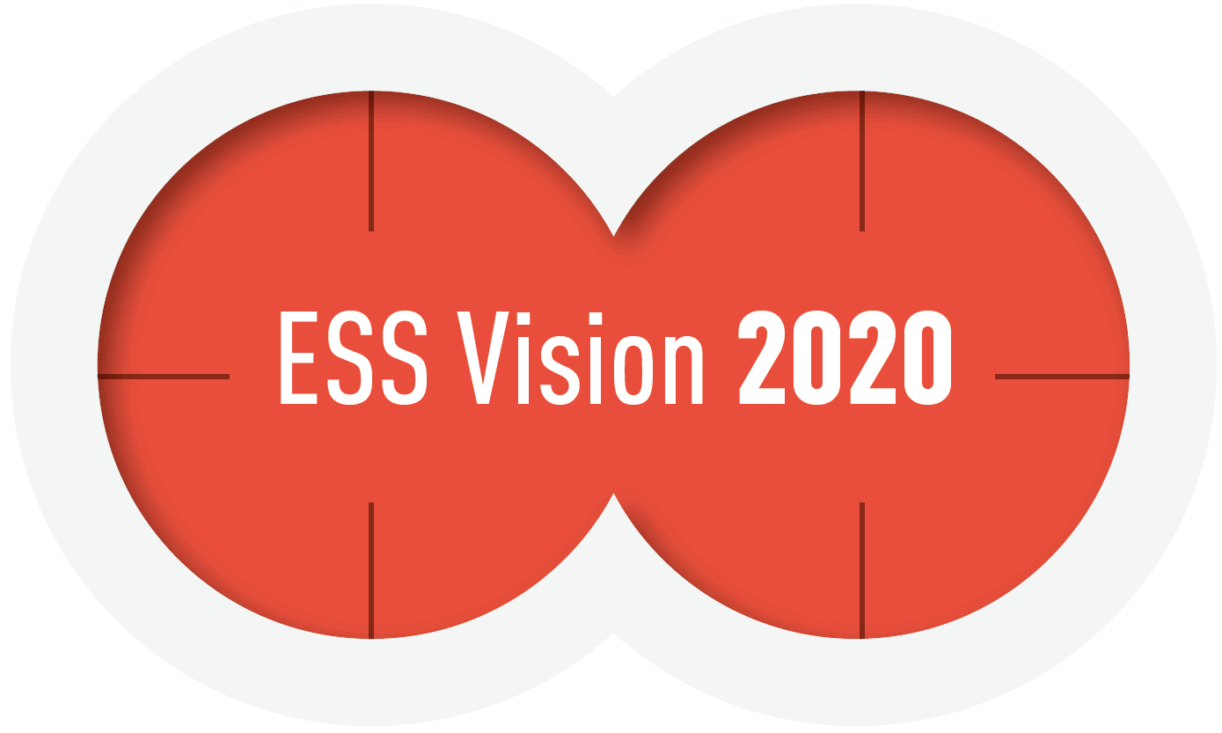
Target outcomes
SDMX is the foundation of a more integrated global statistical system: more open, more timely, more comparable and more accessible data for all.
2020
SDMX is well connected in the evolving web of data standards, enabling seamless integration between standards
SDMX expands to reach and involve new communities beyond Official statistics: private sector partners, end users of data

Slide 4

SDMX Roadmap 2020
Implementation
Simplification
Modernisation
Communication
Notes:
In order to reach these outcomes, the SDMX Sponsors have committed to an action plan, the SDMX Roadmap 2020, which rests on four pillars:
Implementation: Extending the use of SDMX to additional statistical domains and to additional domains, through the encouragement of SDMX-based data sharing agreements. This also includes extending the use of the SDMX for the exchange of reference metadata, not just for data.
Simplification: SDMX is often perceived as complex. One of the key elements of the SDMX 2020 Roadmap is to make data consumption easier by increasing the number of SDMX-compatible formats, encouraging compatibility and seamless integration with other standards and developing supporting tools for the visualisation of SDMX data.
Modernisation: The standards themselves will need to keep up with evolving needs. The goal is to further incorporate data validation functionalities within the SDMX standard, as well as to further develop the IT infrastructure supporting SDMX to cater the needs of a growing and more diverse audience.
Communication: As the pool of SDMX users grows, so will the need for a more proactive approach to communication and capacity-building.

Slide 5







54 joint actions foreseen
UNSD
World Bank
Notes:
The roadmap is jointly implemented and monitored by the seven Sponsors Organisations. Over 50 actions are currently foreseen and being implemented as part of the SDMX Roadmap 2020.

Slide 6




Achievements
Strengthening the implementation of SDMX
Making data usage easier
New Global DSDs for SDGs, Price Indices, SEEA and Education (and Labour statistics very soon!)
New guidelines for “Modelling Statistical Domains with SDMX” released
New version of the “SDMX Glossary”
SDMX-CSV format released, SDMX-JSON update
Modernising statistical processes and improving standards
Better communication and capacity building
New SDMX software tools made available, and from a larger variety of organisations
New version of the SDMX RESTful API published
VTL 2.0 released
New format for the biannual SDMX Expert group agreed and implemented
First “Training the Trainers” capacity-building event
Notes:
Through the implementation of the SDMX 2020 roadmap, we were able to achieve several important results.
We now have global DSDs for a larger variety of domains. Price statistics was added to the existing set of DSDs for macro-economic statistics. With DSDs for Education and for Economic-Environmental accounts, we have had our first global DSDs outside of the macroeconomics domain.
New formats to express SDMX data, reflecting the latest trends in the data science and data visualisation communities.
A Validation and Transformation Language (VTL) was released. VTL will allow the encoding of validation rules for SDMX data, integrating an important aspect of data quality within the standard.
As the SDMX community has grown, the need for capacity building has increased. The Sponsors have thus renewed their commitment to capacity building and introduced new training formats and mew training material to reach an increasing number of people.

Slide 7
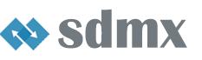
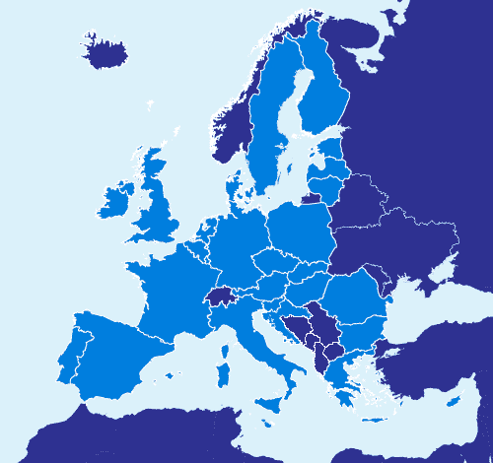

SDMX in the European Statistical System
Reference metadata
Data
Notes:
In the European Statistical System (ESS), SDMX is well on its way to act as the backbone for data exchange, metadata exchange and data validation between EU Member States and Eurostat:
80% of the metadata and quality reports sent to Eurostat is SDMX-compliant
SDMX data exchange is now firmly entrenched in several key statistical domains (national Accounts, Balance of Payments, Short-Term Statistics, Labour Cost Index), and the list is growing!
SDMX is becoming the backbone of Eurostat’s architecture for the validation of data sent by Member States
The close collaboration on standards within the European Statistical System has made it possible to advance at a good pace on the usage of SDMX.

Slide 8


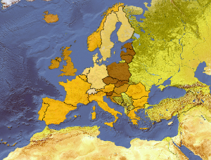
The final stretch
Microdata
Data quality
Geospatial
A public consultation on the proposed features for a new version of the SDMX standard has been launched on SDMX.org.
Results to be unveiled tomorrow!
Notes:
As the work on the implementation of the Roadmap progressed, it became increasingly evident that the realisation of the ambitions of the 2020 roadmap requires some changes to the SDMX technical standards.
The SDMX Sponsors therefore launched a public consultation in June on the potential features of a new version of the standard. The results of the public consultation will be discussed during session 7.

Slide 9
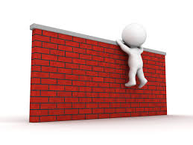
Beyond 2020
What are the priorities for the further evolution of the standard and of the community?
How do we involve this community better in the evolution of SDMX?
How do we ensure SDMX is ready for the challenges of a new age (Big Data, Internet of Things etc…)?
Notes:
2020 is right around the corner! The SDMX Sponsor need a new Vision for the coming years, and we need your input as well. One of the main ambitions of this conference is to discuss with you the general direction the standard should take, to understand your needs in the further development and implementation of SDMX, so that these can become the driving force behind our new strategic Vision.
This is why the conference is called “SDMX for you”: it is an opportunity for the community of users to assess the progress made so far and weigh in on the main challenges that lie ahead.

Slide 10
Thank you for your attention!

