Slide 1
SDMX IT building blocks

Slide 2
SDMX Tools for Data Reporting

Slide 3
SDMX for data reporting
Data reporting is the most common SDMX implementation scenario at national level: data providers are asked to provide data to international organisations according to SDMX specifications.
There are three main different scenarios for data reporting, and each scenario implies a different IT architecture:
Push mode
Pull mode
Hub mode

Slide 4







Push Mode
1
GET SPECIFICATIONS
2
PUSH
3
PREPARE

Slide 5






Push mode: option 1 – lightweight approach

Slide 6



Push mode: option 1 – lightweight approach
The NSI only needs a Converter tool to convert its native files in the desired SDMX format, using the DSD provided by the agency it needs to report to.
DSD
Local Application/ Manual generation
SDMX Converter
Non SDMX File
SDMX File

Slide 7

Format Converters
SDMX Converter (Eurostat)
Excel2SDMX (ISTAT)
Fusion Transformer (Command Line Interface only)
SMART (ILO)

Slide 8

Push mode: option 2 – industrial approach

Slide 9
Push mode: option 2 – industrial approach
The SDMX-RI is a DB Mapping suite conecting directly to the native database is recommended. The SDMX-RI helps map the DSD provided by the data receiver with the information in the database, and to extract it in an SDMX format.
DSD
SDMX-RI
Send to data consumer
SDMX File

Slide 10
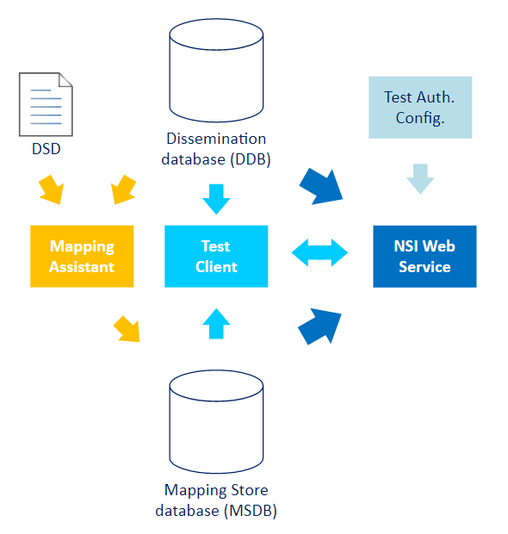
SDMX-RI architecture
Mapping Assistant maps Legacy DB structure to DSD
SDMX-compliant web service returns SDMX data by retrieving them from the legacy database and applying the mappings in the Mapping Store
Legacy
database

Slide 11

DB Mapping suites
SDMX-RI Suite (Eurostat): it includes the mapping assistant, the SDMX-RI Web Service and the NSI Test Client
Data Manager (ISTAT): The Data Manager is a DB mapping tool made available by ISTAT. It reuses the SDMX-RI Web Service as one of its components
The SDMX-RI is covered in detail in Eurostat's SDMX IT tools ESTP course!

Slide 12

Pull Mode
3
2
SEND NOTIFICATION
GOODS ARE READY
1
PULL
4
PREPARE

Slide 13
Pull Mode
The Pull Mode requires NSIs to expose their data via web services using a DB Mapping suite, and to set up a registration with te SDMX registry used by the interested international organisation(s).
SDMX Registry
2
REGISTRATION
SEND NOTIFICATION
3
SDMX-RI
International Organisation
PULL
4
1
PREPARE

Slide 14



Hub Mode
2
REQUEST
REQUEST
1
3
PREPARE
4
SEND

Slide 15

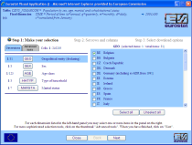

How Hub works
National Statistical Institute
National Statistical Institute
Eurostat Census
Hub
Architecture needed on NSI side same as in Pull mode

Slide 16
Tools for other SDMX use cases

Slide 17
SDMX for data dissemination
SDMX can also be used as a basis for a public dissemination infrastructure for statistics. Such a use case has been implemented in e.g. Eurostat or ISTAT.
The architecture needed for this is similar to the one used for the Pull mechanism or Hub. However, in addition to a DB Mapping Suite, two additional elements are needed:
The NSI needs an SDMX Registry to manage and store the objects (e.g. DSDs) needed for dissemination (this is not needed for reporting, as the structures are provided to the NSIs by international organisations)
The architecture should include a visualidation tool (Data Browser) for users

Slide 18
SDMX for data dissemination
SDMX Registry
DSD, Codelists, etc…
SDMX-RI
Visualisation tool (Data Browser)

Slide 19

SDMX Registry
Euro-SDMX Registry (Eurostat)
Fusion Registry (Metadata technologies): Community Edition (free) and Enterprise edition (subscription service)
Meta Manager (ISTAT)

Slide 20

Visualisation tools
SDMX-RI Web Client (Eurostat)
Web data Browser (ISTAT)

Slide 21
SDMX for data science
This use case focuses on using SDMX data for analysis and research. The organisations mainly applying this use cases are universities / research institutes, but NSIs that also have a focus on the analysis or international comparison of data can be interested as well.
This use case relies on the use of visualisation and analysis tools (mostly connectors) to query SDMX data sources and SDMX registries via the standards SDMX web services.

Slide 22
SDMX for data science
SDMX Registry
Data analysis tools (connectors)
SDMX Data web services

Slide 23

Data Analysis tools / SDMX Connectors
Excel: ILOSTAT Excel Add-in (ILO), Fusion XL (Metadata Technologies)
R: rsdmx, readsdmx, RJSDMX packages
Python: pandaSDMX package
JAVA / MATLAB / SAS: SDMX connectors by Banca d'Italia

Slide 24
Conclusions

Slide 25
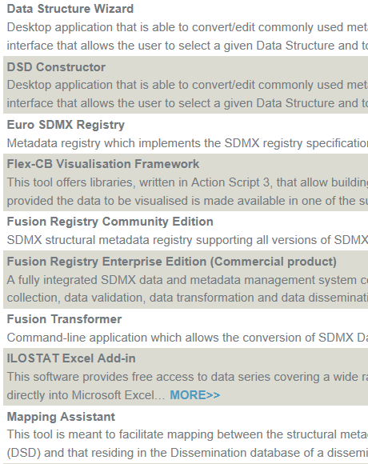

SDMX Tools
List of available SDMX tools on SDMX.org: https://sdmx.org/?page_id=4500
What do they all do?

Slide 26

Many SDMX tools are available, and many of them are open source and free
Different SDMX tools offer different capabilities. The capabilities and architecture you need depends on the specific use case you are interested in
Many solutions are available for each major component / capability

