Slide 1
SDMX meeting Big Data technologies
Storing SDMX time series data in Hadoop
SDMX Global Conference 2019
Budapest, 17/09/2019
Stefano Pambianco

Slide 2
Overview
1
Why exploring BigData technologies
2
Different options for storing data
3
Data modelling and security aspects
4
Conclusions

Slide 3
1
Why exploring BigData Technologies
Some numbers

Slide 4
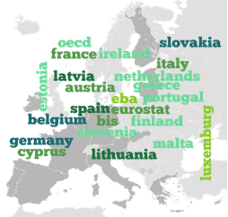
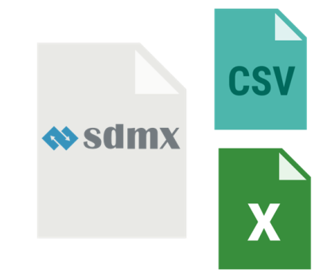
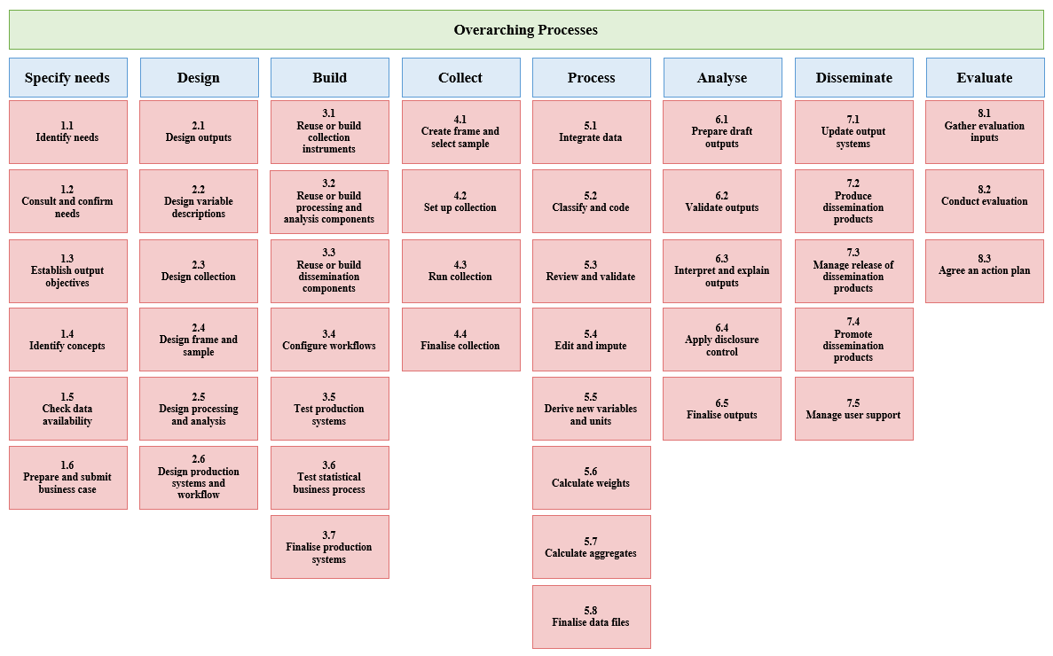
ECB Statistical Data Production in numbers
[Please select]
[Please select]
>50 different data providers
400 datasets
400 million series
40 billion distinct observations
360 SDMX files per day
350GB/year of new data ingested
~1000 data producers/analysts
More dataset coming with more granular data

Slide 5
2
Different options for storing data
Evaluated approaches in Hadoop

Slide 6
Hadoop data storage options
HDFS with Parquet
HBase
Kudu
Column-oriented, NoSQL database management system
Random read / write access in real time to a very large set of data.
Fault tolerant (replication)
Runs on top of HDFS
Scalable and fast tabular storage
SQL-like schema: finite number of typed columns
Low-latency random access
Fault tolerant (tablets replication)
File based storage
Performant batch ingestion
Efficiently scanning large amounts of data
Fault tolerant (replication)
Only data append possible

Slide 7
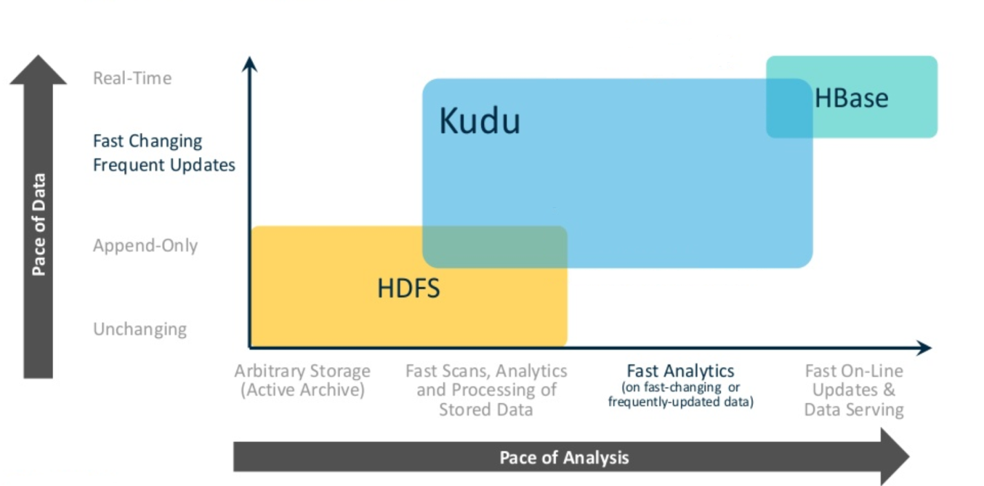
Looking to statistical data production process
[Please select]
[Please select]
Prototypes have been implemented using HBase

Slide 8
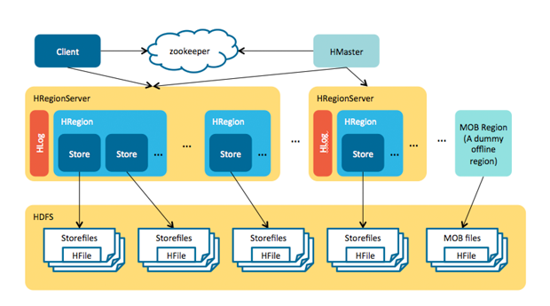
HBase architecture
Notes:
HBase has three major components i.e., HMaster Server, HBase Region Server, Regions and Zookeeper.
Region
A region contains all the rows between the start key and the end key assigned to that region. HBase tables can be divided into a number of regions in such a way that all the columns of a column family is stored in one region. Each region contains the rows in a sorted order.
Many regions are assigned to a Region Server, which is responsible for handling, managing, executing reads and writes operations on that set of regions. A table can be divided into a number of regions. A Region is a sorted range of rows storing data between a start key and an end key.
A Group of regions is served to the clients by a Region Server.
HMaster
HBase HMaster performs DDL operations (create and delete tables) and assigns regions to the Region servers as you can see in the above image.
It coordinates and manages the Region Server (similar as NameNode manages DataNode in HDFS).
It assigns regions to the Region Servers on startup and re-assigns regions to Region Servers during recovery and load balancing.
It monitors all the Region Server’s instances in the cluster (with the help of Zookeeper) and performs recovery activities whenever any Region Server is down.
It provides an interface for creating, deleting and updating tables.
Zookeeper
Zookeeper acts like a coordinator inside HBase distributed environment. It helps in maintaining server state inside the cluster by communicating through sessions.
Every Region Server along with HMaster Server sends continuous heartbeat at regular interval to Zookeeper and it checks which server is alive and available as mentioned in above image. It also provides server failure notifications so that, recovery measures can be executed.

Slide 9
3
Data modelling and security aspects
Findings and ideas

Slide 10
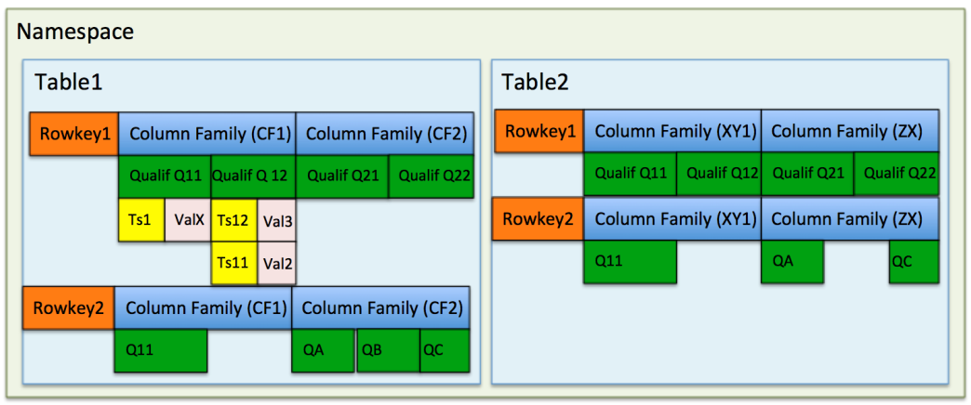
HBase data model
HBase is schema-less, column-oriented datastore designed to store denormalized data
Namespace
- Table
- Column Family
- Qualifier/Column
- Cell
(Timestamp&Value)
- Versions
Notes:
The Apache HBase Data Model is made up of different logical components such as Namespaces, Tables, Rows, Column Families, Columns, Cells and Versions.
A namespace is a logical grouping of tables analogous to a database in relation database systems.
HBase tables are logical collection of the multiple rows stored in a separate region partition. Rows are stored on the row key of the HBase table.
A row is consists of row key and one or more qualifiers with values associated with them. The rows are sorted and stored based on the row key of the given table.
One or more column in the HBase table are grouped together as Column Families. Column is identified by the column qualifier concatenated with column family name. For example, ColumnFamily:ColumnName. Rows in the HBase tables can have multiple columns.
Columns in the HBase tables are grouped together into column families. Each row in HBase can have one or more column families and multiple columns associated with them.
A cell in HBase stores the data and is a unique combination of row key, column family, and column qualifier, and contains a value and a timestamp.
The data stored in a cell is versioned and versions of data are identified by the timestamp associated with them. The version number is configurable and by default it is 3.

Slide 11
Storing SDMX time series in HBase
An SDMX observation is identified by the values of its dimensions, it provides with an observation value for a given reference date and it has several attributes attached
Table
M.USD.EUR. SP00.A
OBS
ATTR
STATS
EXR:
TS
2018-12-31
OBS_CONF
2018-12-31
OBS_STATUS
2018-12-31
NUM_OBS
2018-12-31
FIRST_PERIOD
2018-12-31
HBase TS1
ObsVal 1.12
HBase TS1
ConfVal F
HBase TS1
StatVal A
HBase TS2
Value 9
HBase TS2
PerVal 20011231
HBase TS2
ObsVal 1.09
HBase TS2
ConfVal F
HBase TS2
StatVal A
The data model can be adapted based on access patterns and informational needs

Slide 12
Some insights on performance
The work done until now is based on a prototype developed internally.
Tests ran using a randomly generated dataset of 1.76M time series, each containing 1825 observations (daily observations for 5 years) for a total of more than 3 billion observations
Data retrieval scenarios tested go from milliseconds to retrieve a TS or a partial/wildcarded TS to few seconds to retrieve wildcarded TSs or the full dataset.
Data processing scenarios (e.g. aggregation on one and more than one dimensions, outlier detection, completeness checks) are in the order of seconds.

Slide 13
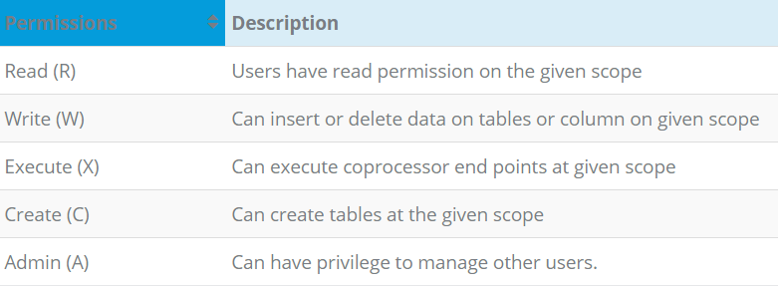
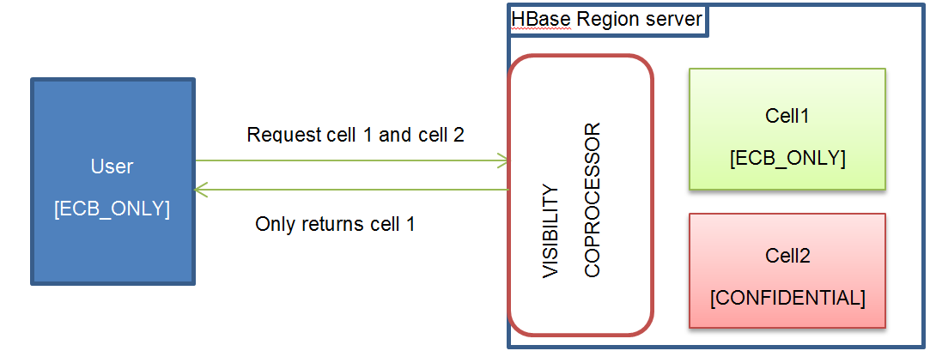
Security aspects
Access Controller
A prototype has been done to assess the impact on performance and the capabilities of HBase applying security rules to the data stored:
Secure authentication using Kerberos
Authorisation managed by HBase coprocessors:
Access Controller
Visibility Controller
Visibility Controller
No data leakage
Minimal impact on data operations (less than 1 % = cost of metadata writing)

Slide 14
4
Conclusions
and Q&A

Slide 15
BigData is a fit for SDMX data
The combination of big data technologies with SDMX appears to be a powerful tool to cope with the future challenges in statistics
Storing and retrieving data is very fast
HBase data model provide with the flexibility to model the data according to the specific needs – same data can be modelled in different ways
SDMX data model fits well into the HBase one
Data security can be pushed at the level of the cell with no impact on performance

Slide 16
Q&A

