Slide 1


SDMX at the International Labour Organization
SDMX Global Conference
16 – 19 September, 2019 – Budapest, Hungary

Slide 2
Once upon a time…
Dissemination WS for ILOSTAT – 1st generation: 2013
  Limited number of artefacts and formats delivered
  «Virtual registry» approach: all artefacts generated «on-the-fly» based on the structural metadata information in ILOSTAT
Internal «consumers»
  ILO Knowledge Gateway: very easy integration of statistical DWI
  Country profiles: Desktop and Mobile applications
  Data Mapper: IMF product adapted to consume SDMX API
  WESO and YouthSTATS dashboards

Slide 3
Expanding the use of SDMX
SDMX Query builder
  On line «wizard» to access ILOSTAT data and metadata in SDMX
ILOSTAT Excel Add-in
  Superseeded (with new functionalities) the former «KILM» Excel Add-in
  Replaced the old proprietary WS by the SDMX standard API
ILOSTAT Data Publisher
  Simple to use desktop tool to extract data and metadata from ILOSTAT
  Downloads information for one country ready to upload to .Stat v7

Slide 4
Expanding the use of SDMX
Second generation WS: 2018
  Same architecture as the previous version (on-the-fly virtual registry)
  Based on .Net NSIWS by Eurostat
  Implements all artefacts and complies with RESTful API v. 1.4 specification
  Delivers all available formats: SDMX-ML, SDMX-csv and SDMX-json
ILO.Stat based in SIS-CC Data Explorer
  DE «connects» to ILOSTAT by consuming the new WS
  No changes in ILOSTAT’s backend

Slide 5













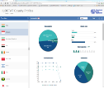

ILOSTAT Modular Architecture
ILO.Stat Modular Architecture
.Stat DE
Reusable Components for the Web
Search | Visualise | Share
SMART
DISSEMINATION
WORKFLOW
CONTROL
VALIDATION &
TRANSFORMATION
METADATA
MANAGEMENT
DATA COLLECTION
Notes:
IT considerations
Modular design following GSBPM
Oracle RDBMS and development tools
Automated procedure for xQ and SDMX uploading with structural consistency
E-Questionnaire online data collection
Single set of metadata
Single interactive consistency procedure regardless of data collection means
«False positives» handling thru allowance issuing
Full screen data editor
Dynamic content dissemination website
Data workflow management module
Data is stored in a relational database mounted on Oracle 11g DBMS administered by ITCOM (the centralized ILO information technologies service). Two postulates have been established for the design of the new data structure: a) the data structure for the data collection database should be the same for all kind of time series data regardless of the periodicity, units of measure, classification breakdown and way of collection; and b) the main (atomic) unit is the “cell” of each table collected, which will be called VALUE and will keep associated dimensions and other attributes.
Although it is a Data Compilation system (and not a proper statistical activity producing microdata), the system has a modular design following the recommendations of the GSBPM, including modules for Data Collection, Data Cleaning, Dissemination, Workflow tracking, Code lists maintenance, User Profiling and Access Control and Source & Methods (See Figure 3: ILOSTAT Information System modular design)
Not included in the diagram
Program development is based on Oracle APEX (Oracle Application Express) for the interactive applications, complemented with some PL/SQL packages and Java classes for specific tasks. Intensive data processing tasks, like consistency checking and Excel questionnaire generation are developed in SAS, accessing the Oracle database. The Workflow control dashboard and dissemination tables and charts are built using Oracle BI Enterprise Edition (OBIEE).
The User Profiling and Access Control module, developed in APEX, includes a dynamic menu that lists the applications available for the user based on his user profile. Examples of them are Statistical Assistants, Analysts, Managers and External Users.
The Data Collection module kept the automatic generation and upload of Excel questionnaires as in the former system, but it has been redesigned as to make use of a single set of metadata fully parameterized and common to both the collection and dissemination processes. The upload procedure (fully automated) performs basic consistency checking and routes the error report to the assigned SA for correction.
The e-Questionnaire application (under development) will be an interactive full screen editor for value and annotations on the data collected developed in APEX and accessible thru the web. It will work on the “Data Collection” work tables and will operate based on the single set of metadata for the QTables.
Electronic Data Interchange, probably using SDMX is in the roadmap for 2012, as a way of reducing the overburden to countries due to the request for information they already have in their databases and has to be transcript to offline or online questionnaires.
The QTable Consistency process, developed in SAS, can be run as a batch process to analyze all records marked “for consistency” in the “Data Collection database” or can be launched on-demand by the SA. This process will pass the correct QTables to “Dissemination” database and mark those erroneous with the respective error codes, remaining in the repository. The assigned SA is notified of the results, and the status of each QTable is updated in the data management system (See Figure 4: Workflow status diagram).
The Editor program is used by the SA to correct the errors detected in the data. This program displays the QTable being edited and the error messages related to it. When using off-line data collection methods, the country user can include annotations in the questionnaire that the Editor will display for the SA to code into notes associated to the data at the right level.

Slide 6
Community work
SDMX v 2.1 plug-in for .Stat v7
  Same architecture as ILOSTAT’s API
  Provides a full SDMX compliant API to .Stat v7 platforms
  Enables a smooth migration to .Stat Suite
    Data and Metadata download
    Data Explorer connected to v.7 backend
Global DSD for
  Price statistics
  Labour statistics
  SDG reporting
Definition of MSD mapping Global MCS to IHSN DDI-C template (work in progress)

Slide 7


Tools
SMART
  Use of SDMX structural metadata to define calculations and data recoding and reformatting
  SDMX-driven data conversion (including microdata)
  Batch utility SMARTcmd.exe allows scripting
  Data reporting without a real SDMX architecture in place
DSD Constructor
  Easy to use tool for creating/editing DSD by combining concepts
  Online connection to any SDMX Registry
  Codelists and annotations management
  Perfect SMART companion tool

Slide 8



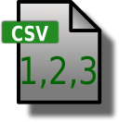








SMART
SDMX Registry
DSD Constructor
ILOSTAT
Structural
Metadata
DSD
SMART
DATA
REPORTING
DATA CONVERSION
Dataset
Microdata
LMIS
UPLOAD
LMI ANALYSIS
Aggregated
Data
MAPPING
Dataset
Notes:
ILOSTAT-ART is a free basic statistical processor that can compute statistical tables (reported indicators) defined by DSD’s, either by processing microdata sets or transcoding aggregate input data. It relies strongly on mappings between input variables and DSD's concepts, which can be saved and reused. This approach ensures the consistency of the output codes since they match the structure of the DSD.
Different file formats can be processed (e.g. Stata, SPSS, csv, SDMX), and produces output “data packages” in Excel, csv or SDMX formats, ready to fulfil the data reporting requirements or feed a .Stat dissemination platform.

Slide 9

Innovation: Electronic data exchange
Non-statistical application of SDMX
Institution 1
Institution 2
1
Define the model of the data to be exchanged
Data
transmission
3
Send data request
Receive request
Authenticate requester
2
7
Receive response
4
Process request:
Prepare data response
8
Authenticate response
Is the sender authorized ?
Data
transmission
Local databases & information systems
5
Encrypt & Sign response
9
Process response:
Insert into local system
6
Send data response
Local databases & information systems

Slide 10
Innovation: Electronic data exchange
Current status:
  A proof-of-concept showed the feasibility of the approach.
  Prototype of death data exchange using the existing SDMX environment.
  Using the SDMX toolkit.
    Including: Data Structure, Data Flows, Data Packages/Sets, Code lists, etc.
  Customisation and Mapping Tools:
    Building Data Flows by selecting data fields from concept schemes.
    Connection of a Data Flow to a local database to generate Data Packages.
  Additional tools:
    GPG4Win: Signature and encryption of Data Packages.
    Nextcloud (in ISSA premises): Secured Communication channel based on shared folders.
    SMART: Desktop tool for converting files among different formats (XML, csv, etc.)

Slide 11
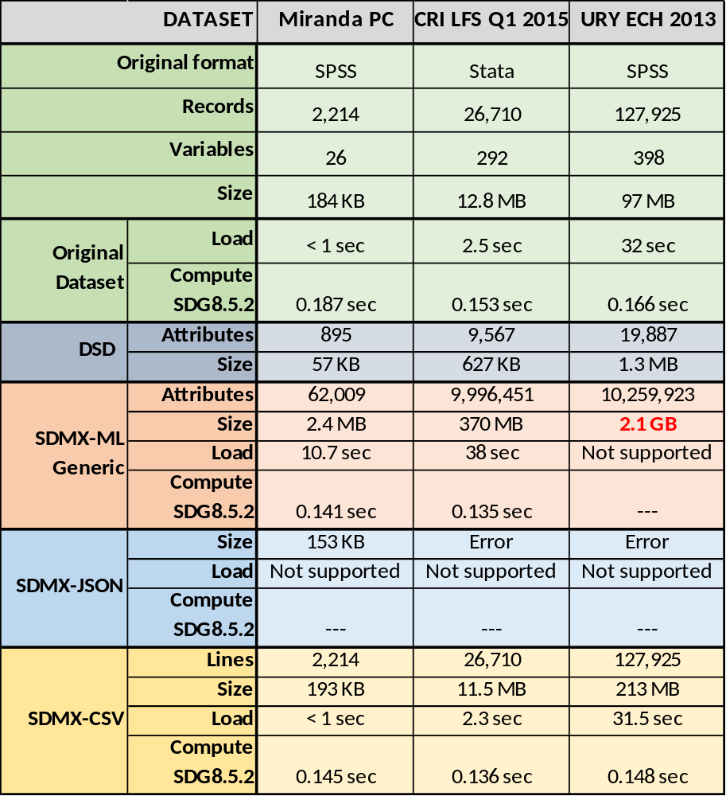
Innovation: microdata in SDMX
PoC on microdata processing in SDMX

Slide 12
Innovation: CSV Structural Metadata
Four data message formats: EDIFACT, xml, json and csv
  UN/EDIFACT
    SDMX-EDI only suitable for time series data
  xml:
    widely used for representing documents and general data structures
    base format for communications protocols and web services
    requires IT knowledge
  json:
    «new generation» data exchange format (2000s)
    highly oriented to web development
  csv:
    very popular data exchange format, partially standardized (RFC4180)
    Every spreadsheet or statistical package can import csv data

Slide 13
Innovation: CSV Structural Metadata
SDMX-csv format supported for data messages only
csv datasets are very efficient for statistical processing
The lack of structural metadata messages in csv makes it difficult to access to categories’ valid codes and labels in these packages
Code lists can be represented in csv without effort.
An structural metadata artefact in csv format is required to link the dataflow to its DSD, conceptSchemes and codelists (work in progress)

Slide 14
Thank you !
Edgardo Greising
Head of Knowledge Management and Solutions Unit
STATISTICS - ILO
greising@ilo.org
sdmx@ilo.org
Visit us at https://ilostat.ilo.org

Slide 15

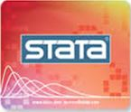

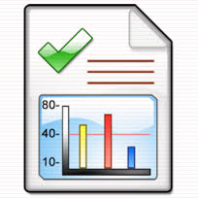


Data Reporting
Data reporting without a real SDMX architecture in place
Primary Statistical
Activity
Notes:
One year ago, during the “Meeting of Experts 2016” in Aguascalientes, MEX, we discussed during the Breakout Session 2 “How to design and build an SDMX Enterprise Architecture”.
Amongst the three basic scenarios presented, the so called “Light” intended for data reporting only and without a real SDMX architecture in place, happened to be recognized as a quite common situation along data producers in developing countries. Many of them lack a central repository of indicators, and the information to be reported is “spread” inside the institution in a number of different formats and media.
Some tools are available from the SDMX community to help initiating the data reporting in SDMX, like the SDMX-RI Mapping tools to generate a “PUSH” mode flow, or the SDMX Converter if no database where SDMX-RI can be plugged in.
Nonetheless, quite often (just to make it a bit more difficult) the structure of the indicators calculated by the data producer for its internal use differs from the specification of the information to be reported which, for example, uses a different variant of a classification breakdown. In this case, the microdata needs to be re-processed to generate the outputs with the right structure.
Questionnaires in Excel, require manual transcription of data (and metadata) → Experts won’t do this job.
Questionnaires arrive late, when the survey has already been processed and published → Experts are likely to be engaged in another project.
Breakdowns are different from those used at national level → Requires re-processing including new mappings
Variables definitions may differ from those used at national level → Requires re-processing including new calculations

Slide 16
ILOSTAT SMART facts
No indicators’ database is required
Tables defined dynamically via a DSD
Selectable classifications’ versions and variants
Flexible mapping
Conditions applied on-the-fly to tally/sum/avg
Mapping can be saved and re-used
Multi-language
ILO standard routines for derived variables (*)
Stand alone + on line access to any SDMX registry and/or Data API
Process microdata or aggregate datasets in Stata, SPSS, SDMX and csv
Several output formats: .xls, pdf, csv, sdmx
Desktop and Online(*) versions
(*) Coming soon

Slide 17
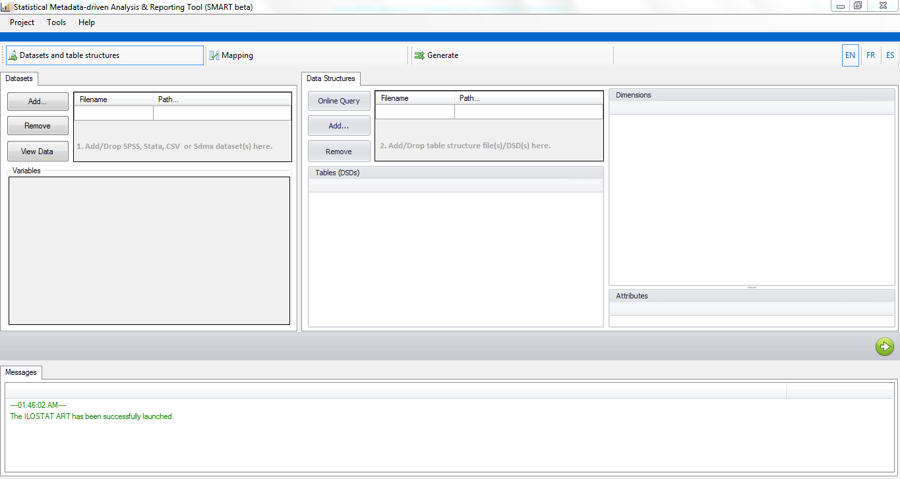

Slide 18
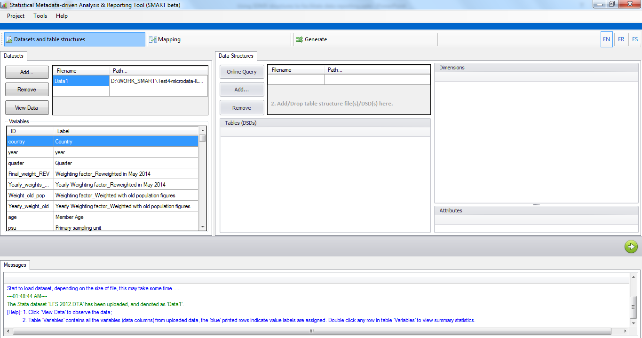

Slide 19
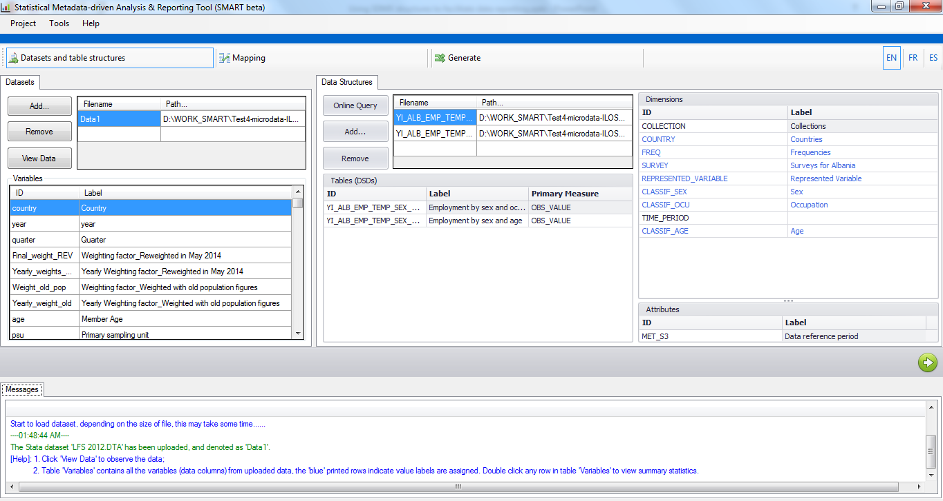

Slide 20
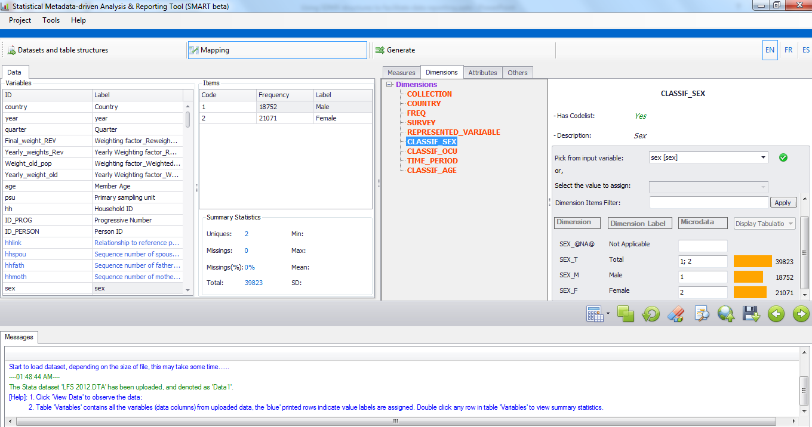

Slide 21
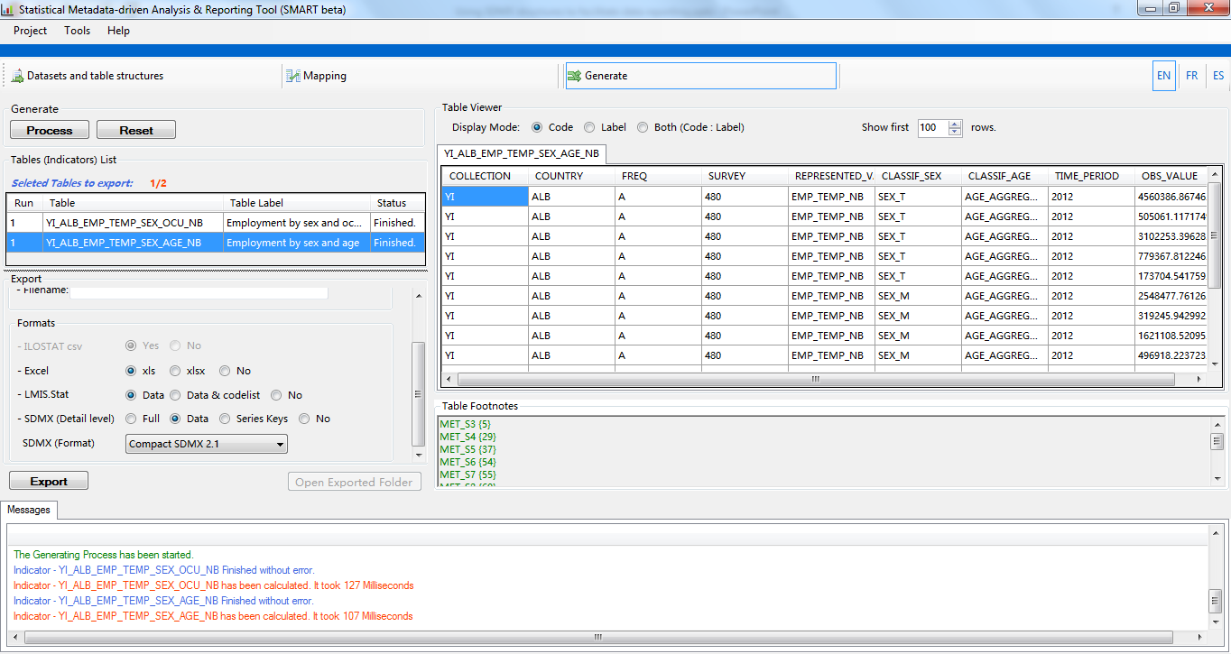

Slide 22
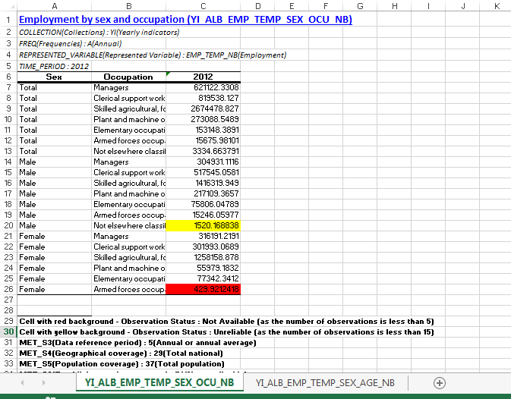

Slide 23
Thank you !
Edgardo Greising
Head of Knowledge Management and Solutions Unit
STATISTICS - ILO
greising@ilo.org
sdmx@ilo.org

