Slide 1
Automating Data Collection with SDMX
September 17, 2019
Andreas Hake
STADO Division Chief, Statistics Department
Bachir Boukherouaa
ITDES Division Chief, IT Department
The views expressed herein are those of the authors and should not be attributed to the IMF, its Executive Board, or its management.

Slide 2
Presentation Outline
The IMF Data & Statistics Strategy
Global Data Commons: a Key Priority
Moving from Push to Pull Model
The Role of SDMX in Meeting the Objective
Key Benefits and Challenges
Automated Data Collection Platform
Supporting Activities
Conclusion

Slide 3
Introduction
Unprecedented volume of data – set for worldwide digital data to increase by 45 times by 2020 relative to 2009.
With surveillance priorities evolving and the need to analyze more heterogenous and larger amounts of data will require the IMF to work intensively and extensively with official and other data (commercial and non-structured).
This fast-changing data landscape, new data needs for evolving surveillance priorities, and persisting data weaknesses pose challenges for the Fund and its members.

Slide 4
The IMF Overarching Strategy on Data and Statistics
Data & Statistics Strategy
Support for Big Data
Build Global Data Commons
Secure, share high quality data
Address data weaknesses
Cross country data comparability
Be agile in data need
The Fund’s overarching strategy established in spring 2018 is thus to move toward an ecosystem of data and statistics that enables the Fund to better meet its evolving data needs in a digital world.
Six strategic priorities have been identified to address the fragmentation of the data and statistics landscape, including the construction of a Global Data Commons

Slide 5
The Global Data Commons – a key priority
Data dissemination is a public good that promotes transparency, helps lower borrowing costs, and should be harnessed to better support data provision to the Fund
The vision expressed is to integrate country websites developed under the IMF’s data dissemination initiatives into a universal network that publishes data for the common good—a global data commons
Includes capabilities for SDMX-based machine-to-machine data transmission allowing data consumers to automatically collect data from country websites
Allow for voluntarily moving from the current “push” system for data reporting (in which countries send their data to the Fund and other parties) to a “pull” system (where countries upload their data to a single web-based repository, allowing all users—including the Fund—to draw on the data)
The aim is to further reduce the countries’ reporting burden, promote open data principles, optimize the use of scarce resources in official statistics and minimize the amount of transmission errors introduced by manual interventions

Slide 6
Moving from Push to Pull Model
Push model – Tax forms
Specific reporting requirements
Data provided in forms with specific formats
Pull model – Newspaper
Superset - users can take what they need
Single source

Slide 7
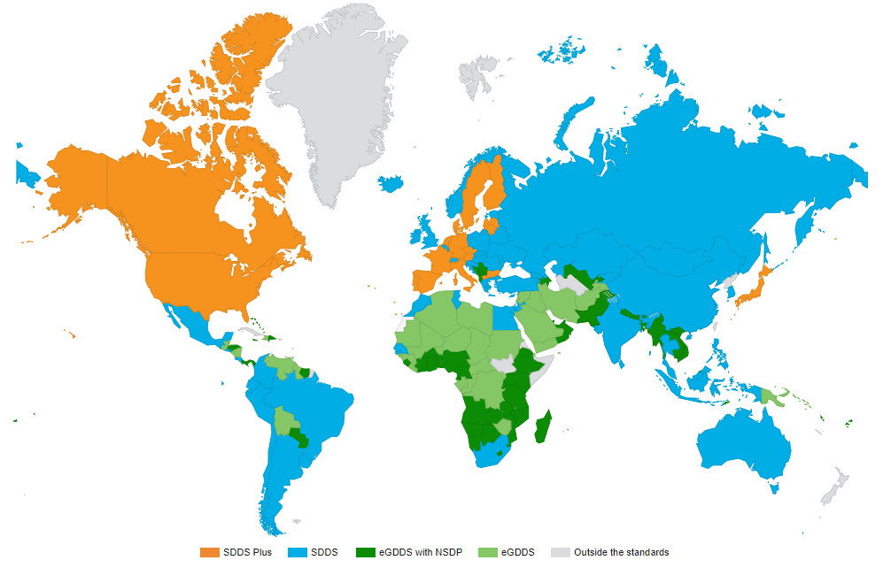
Data Dissemination Standards adherence
Source: dsbb.imf.org
Notes:
Where we stand today:
188 IMF economies: 112 GDDS (57 with NSDPs); 58 SDDS (3 with SDMX); 18 SDDS Plus
115 countries publish macroeconomic and financial data on National Summary Data Pages (NSDPs) in accordance with the IMF Data Dissemination Standards
Most SDDS NSDPs still follow the old format providing the latest data point in HTML format (not machine readable)
Today, SDDS Plus and e-GDDS NSDPs are the start of the Global Data Commons (75 NSDPs + 3 SDDS NSDPs = 78 NSDPs supporting SDMX format)

Slide 8
The Role of SDMX in Meeting the Objective
SDDS Plus has been introduced as a new tier in the IMF’s Data Standards Initiatives in 2012 (additional data categories, longer times series) supported by a new NSDP format:
Leverages existing dissemination infrastructures to browse data hosted by different national agencies (following existing practices, formats, “look and feel”)
Eliminates the need for a coordinating agency to centralize the publication of the NSDP data
All data on the NSDP are available in SDMX-ML format (one file / query per data category)
Contributing agencies can post/register their SDMX files directly
Notes:
SDMX as dissemination format for SDDS Plus was proposed by many members
NSDP data are coded in SDMX in accordance with an IMF dissemination DSD (ECOFIN) or Global DSDs (e.g. BOP, SNA; SDDS (Plus) mandatory)
The successful implementation of the SDDS Plus dissemination model paved the way for enhancing data access for the 180 economies in SDDS/e-GDDS
The AfDB’s Open Data Platform is adopting SDMX and the NDSP-DSD for the dissemination of economic and financial statistics
The adoption of SDMX and the NSDP-DSD for SDDS would require consultation with SDDS subscribers

Slide 9
Key Benefits
For country authorities as data providers:
Reduce reporting burden
Data Integrity and consistency
Reduce effort to send data in different format to different organizations
Lower cost
For data consumers (like the IMF):
Timely data
Comparability with other institutions
Standardization of data reporting

Slide 10
Challenges
For country authorities
Need to acquire SDMX competence and infrastructures to disseminate data in SDMX-ML format coded in accordance with the standards
Require more coordination between local data providers
For data consumers (like the Fund)
Data disseminated on NSDPs are often only a subset of the data reported to the Fund
Need to change data feed infrastructure

Slide 11
Road to Success
Cloud-based Excel to SDMX converter service
Remote support to country authorities with data mapping from internal codes to SDMX for SDDS Plus and e-GDDS
Missions to low income countries to support the setup of an e-GDDS National Summary Data Page offering data in both human-readable and SDMX formats
Externally funded mission support to low income countries who want to introduce SDMX as data reporting format to the IMF
Teamed with the AfDB in Africa to leverage the “Open Data Platform” implemented as part of the AfDB “African Information Highway” initiative
The IMF has enhanced its data collection platform to facilitate the automated data collection from different sources supporting different SDMX versions and protocols
The IMF has improved its internal data ingestion infrastructure to seamlessly switch from data reported through traditional collection forms to data in SDMX format.

Slide 12
IMF Automated Data Collection Platform
Over 70 external datasets
From 9 data providers EuroStat, ECB, OECD, UN, ILO, WB, BIS, US Census Bureau, and Bloomberg
NSDP underlying data links – 689 URL instances;
Diverging formats SDMX 2.0 or 2.1 standards, GESMES, JSON and CSV format
Heterogeneous protocols RESTful, RESTful secure, SOAP, SOAP Secure web service
Other Challenges:
Complex codebase
Unsatisfactory performance
Business overreliance on development team

Slide 13
Conclusions
The IMF has identified SDMX as a key technology to implement its strategic goal to build a Global Data Commons
The Global Data Commons will offer everybody free access to a rich set of economic and financial data of economies
This will help to migrate the data reporting to a self-service system to reduce countries’ reporting burden
Notes:
Key to the IMF strategy on data and Statistics is the “Global Data Commons” – an ambitious, cloud‑based platform for gathering large quantities of data from IMF members. The aim is to bring all of the data together in one place in an readily comparable format, making use of common data standards and methodologies. Researchers, journalists and members of the public should no longer be required to trawl through an array of often-labyrinthine websites belonging to national statistics offices and instead be able to access all of the data through a single portal.
We will be able to confront the data – the best way to improve data is to confront it. It is like having a mirror of yourself, you see where the things are that need to be corrected. The data commons will link national statistics websites in the cloud, translating everything into the common Statistical Data and Metadata eXchange (SDMX) standard, which allows straightforward machine‑to‑machine data sharing. From there, anyone accessing the data can download it in whichever format is most convenient.
While all Fund members will benefit from the global data commons, there will be even greater gains for low‑income countries, and small and fragile states where streamlining data requests would ease capacity constraints.

Slide 14
IMF DSD for Economic and Financial Statistics
EcoFin – an SDMX data structure for data dissemination and exchange
Purpose
Developed by the IMF to support SDMX dissemination of data covered by the IMF “Data Standards Initiatives” (DSIs)
DSIs cover a very large array of economic and financial statistics
Scope
A single DSD to support dissemination of all data collected and disseminated by the IMF Statistics Department
Structure
Very basic: 5 Dimensions / 1 mandatory attribute

Slide 15
ECOFIN DSD - This is GDP
The Country
The Unit (included in INDICATOR)
REF_AREA
UNIT_MULT
The Data
TIME_PERIOD
OBS_VALUE
INDICATOR
FREQ
The Indicator
COUNTERPART_AREA
DATA_DOMAIN
Notes:
The indicator is a composite with several dimensions folded into it

Slide 16
IMF EcoFin DSD - Benefits
Low entry barrier
Easy to produce data in SDMX format using this strucure
Easy to consume – only one mapping is needed; DSD aligns with how non-statisticians use statistics
Supports “data hubs”: a single “query” to cover vast array economic and financial data needs
Supports “Structure set mappings” to/from DSDs for Global Use (e.g. NA, BOP)
Strong business case:
Beyond the needs of IOs – reaching out to data users
Appealing to mobile apps developers – a single, basic DSD to cover all economic and financial data
Supports exchange of data, as covered by DSDs for Global Use (automated mapping using SDMX “structure set mapping”)

